Slide 1

UNIVERSITY OF LAGOS
SCHOOL OF POSTGRADUATE STUDIES
DEPARTMENT OF ZOOLOGY
GENOME-WIDE ANALYSIS AND DIVERSITY OF PLASMODIUM FALCIPARUM
IN LAGOS AND EKITI STATES, SOUTH-WEST NIGERIA
    OYEBOLA, KOLAPO MUYIWA
    BSc (Hons) Zoology (2008)
    MSc Parasitology and Bioinformatics (2011)
  Supervisors: Dr E.T Idowu
  Dr (Mrs) Y. A Olukosi
  Dr A.A Ngwa

Slide 2
OUTLINE
Introduction
    Statement of the Problem
    Objectives
    Justification
    Definition of Terms
Materials and Methods
Results
Summary of Findings
Contributions to Knowledge
Conclusion

Slide 3
Introduction
Malaria is a parasitic disease responsible for morbidity in 214 million people globally (WHO, 2015)
170 million people are at risk of malaria infection in Nigeria
Extensive genetic diversity/antigenic variation has contributed to the spread of drug resistance

Slide 4
Introduction (cont’d)
Malaria intervention strategies include chemotherapy, vector control and development of vaccines
The extent of genetic diversity and population structure of P. falciparum vary between endemic areas (Joy et al., 2003)
Merozoite Surface Proteins (MSP 1 and MSP 2) are genotyping tools to differentiate recrudescent and re-infection with P. falciparum clones (Takala and Plowe, 2009).

Slide 5
Introduction (cont’d)
Re-infection may be misdiagnosed as recrudescence if clonal distribution or allelic diversity is low
Malaria parasites have developed resistance to a number of antimalarials; chloroquine (CQ) and sulphadoxine-pyrimethamine (SP)
Resistant strains have been shown to disappear from parasite population if drug pressure is removed (Kublin et al., 2003; Laufer et al., 2008).

Slide 6
Introduction (cont’d)
An effective malaria vaccine is expected to make up for the shortfalls in the existing malaria intervention measures.
Vaccine constructs follow the procedures of robust population-specific antigen discovery
Whole-genome sequencing approach can be used to identify new antigens under equilibrium polymorphisms (balancing selection)

Slide 7
Figure 1: Map of Africa indicating endemic populations with information on the genomics of P. falciparum (www.wwarn.com)
Cape Verde
32%

Slide 8
Statements of the problem
1. There is inadequate information on the clonal distribution
of P. falciparum in the country which may affect accuracy in
the evaluation of antimalarial efficacy.
2. Not much is known about the structure and genetic
differentiation between different parasite populations in
Nigeria
3. Little is known about the level of CQ and SP resistance 10
years after policy change to ACT.
4. There is currently paucity of information on potential vaccine candidates against falciparum malaria in Nigeria.

Slide 9
Justification
1. There is the need to understand the clonal distribution of P. falciparum infections within an endemic population with a view to making accurate decisions on the effectiveness of drugs
2. Understanding the genetic structure of different populations of P. falciparum may offer evidence-based and population-specific intervention strategies
3. It is important to identify those genes that are polymorphic and potentially under strong directional and balancing selection from antimalarial drug use and host immunity.
4.This will allow effective translation of P. falciparum genomics into health interventions.

Slide 10
Aim
The aim is to investigate the genome-wide diversity of P. falciparum isolates in Lagos and Ekiti States, Nigeria

Slide 11
Objectives
Determine the allelic variants, clonal distribution, multiplicity of infections and genetic differentiation of P. falciparum isolates in southwestern Nigeria.
Determine the population structure of P. falciparum isolates
Establish the extent of directional selection on genes associated with antimalarial drug resistance
Identify target genes of immunity under balancing selection as candidates of malaria vaccines

Slide 12
Definition of terms
Balancing selection - selection in which polymorphic alleles are actively maintained at equilibrium in the gene pool of a population at frequencies above that of gene mutation.
Clonal diversity – The existence of high frequency of multi-clonal infections
Directional selection - A type of natural selection in which an extreme phenotype of the parasite (e.g drug resistance) is favoured causing the allele frequency to shift over time in the direction of that phenotype.
Multiplicity of infections (MOI) – The number of parasite clones per human infection
Nonsynonymous single nucleotide polymorphism: Change in the amino acid (AA) composition when the reference allele is substituted with the variant alleles
Selective sweep - reduction or elimination of variation among the nucleotides in neighboring DNA of a mutation as a result of recent and strong positive natural selection.
Synonymous single nucleotide polymorphism: No change in the AA composition when the reference allele is susbtituted with the variant allele

Slide 13
List of abbreviations
MSP – Merozoite surface protein
EDTA – Ethylene diamine tetracetic acid
MoI – Multiplicity of Infections
AMOVA – Analysis of Molecular Variance
LD – Linkage disequilibrium
PCoA – Prinicipal Coordinates Analysis

Slide 14
MATERIALS AND METHODS
Participants presenting with symptoms of uncomplicated malaria were recruited at three health facilities (Figure 2):
    State Specialist Hospital, Aramoko, Ekiti State
    St Kizito’s Catholic Hospital, Lekki, Lagos State
    Ajara Primary Health Centre, Badagry, Lagos State

Slide 15
Table 1: Description of study areas
Aramoko (AMK) | Lekki (LEK) | Badagry (BDG)
Rural community in Ekiti State | Urban settlement in Lagos State | Peri-urban community in Lagos State bordering Nigeria and Republic of Benin
Approximately 74, 491 people (NPC, 2006) | Approximately 117, 793 residents (NPC, 2006) | It has a population of 241, 093 (NPC, 2006)
It is an upland zone rising over 250 meters above sea level with characteristic Guinea Forest-Savannah Mosaic Vegetation | It is a coastal area | Coastal
7⁰ 43′ 0′′ North, 5⁰ 3′ 0′′ East. | 6⁰ 25′ 0′′North and 4⁰ 6′ 0′′East | 6⁰ 25′ 0′′North and 2⁰ 53′ 0′′East.
Year-round malaria transmission occurs in all study areas and peaks during the annual rainy season from March to October.

Slide 16
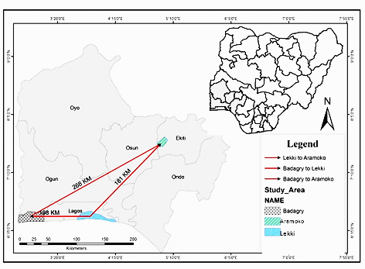
Figure 2: Map of southwestern Nigeria showing the study areas and the geographic distances between them

Slide 17
Experimental design and sample collection
This is a cross-sectional study involving sample collection from participants (2 years and above) presenting with symptoms of uncomplicated malaria at selected health centres in the study areas from February to October, 2013.
Samples were recruited from rural and urban settings to inquire into population differentiation
Up to 5ml of venous blood was collected from each participant in sterile Ethylene Diamine Tetracetic Acid (EDTA) – coated vacutainer tubes
Blood spots were made on 3mm Whatmann filter paper (Whatmann, England) and left to dry
Collected samples were transported in an ice-cold container to the laboratory for further analysis

Slide 18
Recruitment criteria
Uncomplicated malaria
Aged 2 years and above
Temperature of 36 -38⁰C on presentation
History of fever in the previous 48 hours
A minimum of 5000 P. falciparum parasites/ul estimated by thick film examination

Slide 19
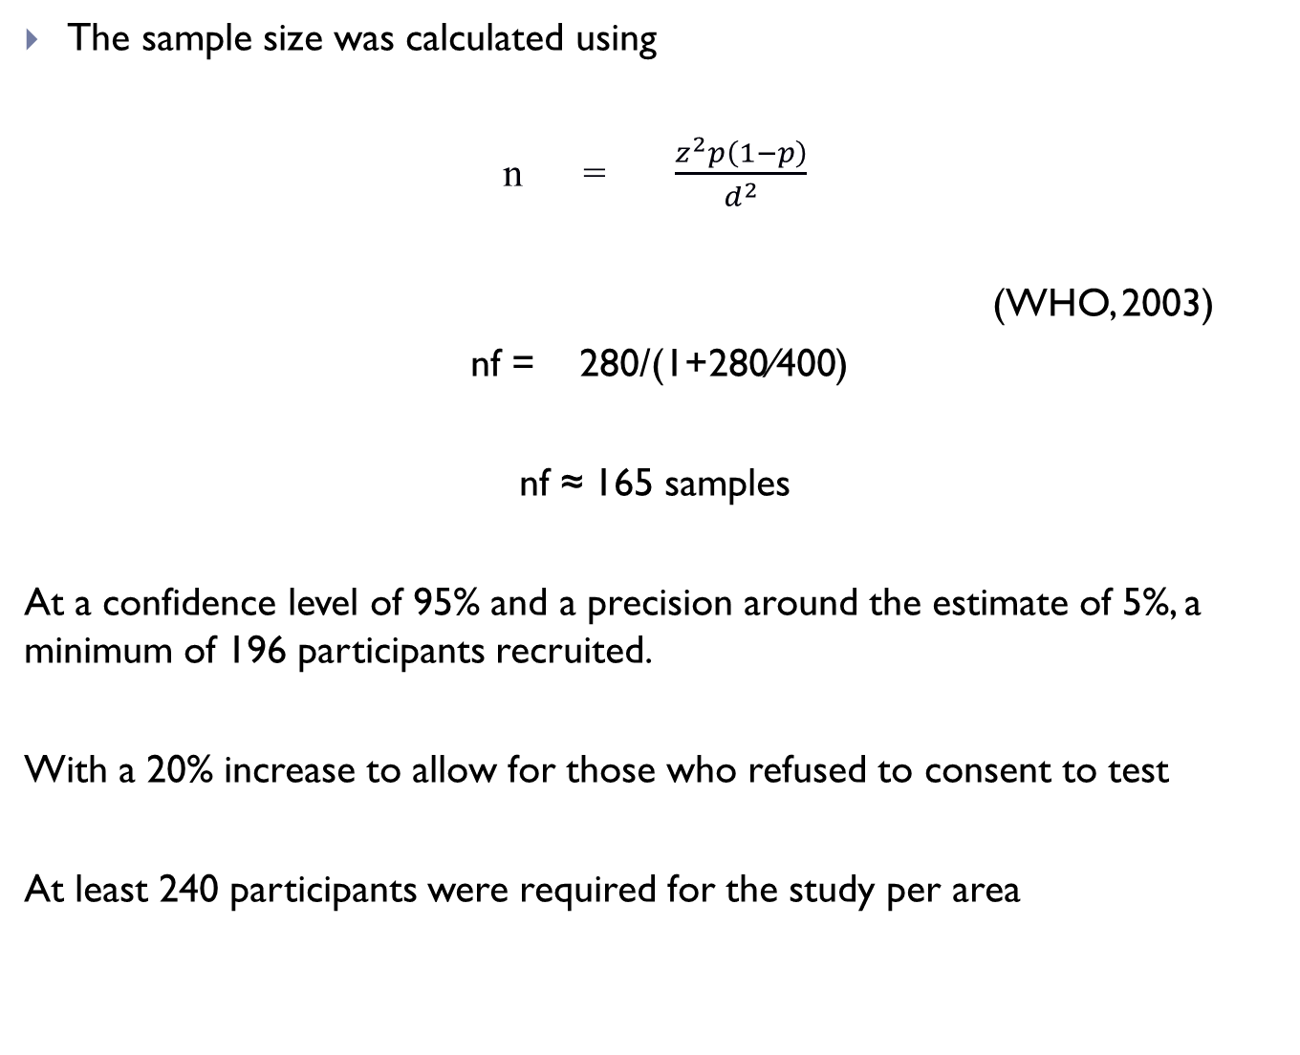
Study population
The sample size was calculated using
n = $\frac{z^{2}p\left(1−p\right)}{d^{2}}$
(WHO, 2003)
nf = 280/(1+280⁄400)
nf ≈ 165 samples
At a confidence level of 95% and a precision around the estimate of 5%, a minimum of 196 participants recruited.
With a 20% increase to allow for those who refused to consent to test
At least 240 participants were required for the study per area

Slide 20
Ethical considerations
Informed consent was obtained from individuals and parental consent and/or assent from under-16 participants prior to recruitment.
Ethical approval (with reference number IRB/12/209) was obtained from the Nigerian Institute of Medical Research (NIMR) ethics committee

Slide 21
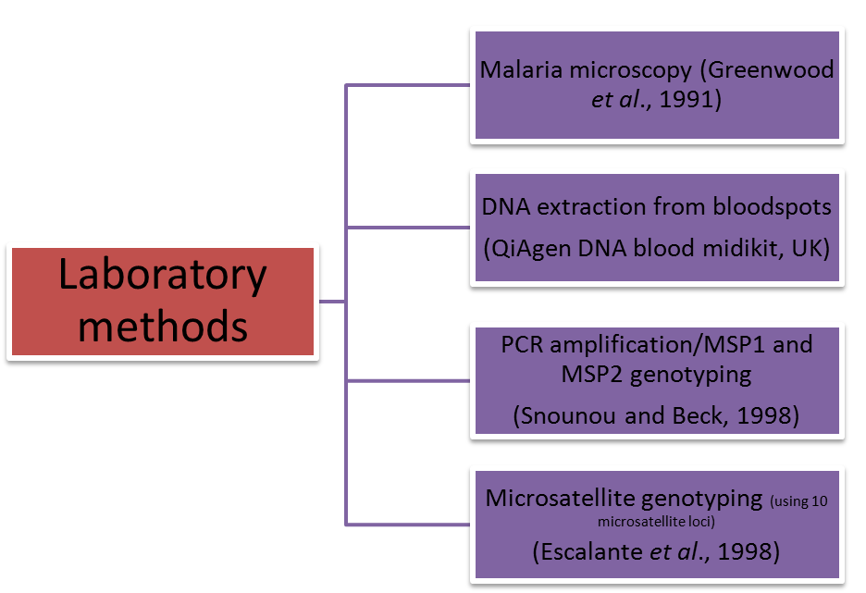

Slide 22
Table 2: Sequences of the primers used to amplify the MSP-1 and MSP-2 genes of P. falciparum isolates
Locus | Primer | Primer sequence
Primary PCR
msp-1 | msp1-P1 | 5′ -CACATGAAAGTTATCAAGAACTTGTC-3′
 | msp1-P2 | 5′ -GTACGTCTAATTCATTTGCAC-3′
msp-2 | msp2-1 | 5′ -ATGAAGGTAATTAAAACATTGTCTATTATA-3′
 | msp2-4 | 5′ -ATATGGCAAAAGATAAAACAAGTG-3′
Secondary PCR
msp-1 | K1-K1 | 5′ -GAAATTACTACAAAAGGTGCAAGTG-3′
 | K1-K2 | 5′ -AGATGAAGTATTTGAACGAGGTAAAGTG-3′
 | MAD20-M1 | 5′ -GAACAAGTCGAACAGCTGTTA-3′
 | MAD20-M2 | 5′ -TGAATTATCTGAAGGATTTGTACGTCTTGA-3′
 | R033-R1 | 5′ -GCAAATACTCAAGTTGTTGCAAAGC-3′
 | R033-R2 | 5′ -AGGATTTGCAGCACCTGGAGATCT-3′
msp-2 | 3D7-A1 | 5′ -GCAGAAAGTAAGCCTTCTACTGGTGCT-3′
 | 3D7-A2 | 5′ -GATTTGTTTCGGCATTATTATGA-3′
 | FC27-B1 | 5′ -GCAAATGAAGGTTCTAATACTAATAG-3′
 | FC27-B2 | 5′ -GCTTTGGGTCCTTCTTCAGTTGATTC-3′

Slide 23
Table 3: Primer sequence and chromosomal locations of the
microsatelllite loci
Name | Label | Sequence | Chromosome
TA1-3(F) | Blue | CTACATGCCTAATGAGCA | 6
TA1-R |  | TTTTATCTTCATCCCCAC
TA1-F |  | CCGTCATAAGTGCAGAGC
TA40-3(R) | Yellow | AGCCACTGTATCCAGCCA | 10
TA40-F |  | AAGGGATTGCTGCAAGGT
TA40-R(2)
Polya-R | Green | ATCAGATAATTGTTGGTA | 4
Polya-F |  | AAAATATAGACGAACAGA
Polya-3(IR) |  | GAAATTATAACTCTACCA
TAA60-F | Green | CTCAAAGAAAAATAATTCA | 13
TAA60-R |  | AAAAAGGAGGATAAATACAT
TAA60-3(IF) |  | TAGTAACGATGTTGACAA
ARA2-3(F) | Yellow | GTACATATGAATCACCAA | 11
ARA2-R |  | GCTTTGAGTATTATTAATA
ARA2-F |  | GAATAAACAAAGTATTGCT
Pfg377-3(R) | Yellow | TTATGTTGGTACCGTGTA | 12
Pfg377-F |  | GATCTCAACGGAAATTAT
Pfg377-R |  | TTATCCCTACGATTAACA
PfPK2-3(R) | Yellow | CCTCAGACTGAAATGCAT | 12
PfPK2-F |  | CTTTCATCGATACTACGA
PfPK2-R |  | AAAGAAGGAACAAGCAGA
TAA87-3(F) | Green | ATGGGTTAAATGAGGTACA | 6
TAA87-R |  | ACATGTTCATATTACTCAC
TAA87-F |  | AATGGCAACACCATTCAAC
TAA109-3(F) | Blue | TAGGGAACATCATAAGGAT | 6
TAA109-R |  | CCTATACCAAACATGCTAAA
TAA109-F |  | GGTTAAATCAGGACAACAT
TAA81-3(F) | Blue | GAAGAAATAAGGGAAGGT | 5
TAA81-R |  | TTTCACACAACACAGGATT
TAA81-F |  | TGGACAAATGGGAAAGGATA
TAA42-3(F) | Green | ACAAAAGGGTGGTGATTCT | 5
TAA42-R |  | GTATTATTACTACTACTAAAG
TAA42-F |  | TAGAAACAGGAATGATACG
2490-3(R) | Blue | ATGATGTGCAGATGACGA
2490-F |  | TTCTAAATAGATCCAAAG
2490-R |  | TAGAATTATTGAATGCAC

Slide 24
6. Genome-wide sequencing of P. falciparum isolates
Whole blood samples in EDTA
Leukocyte depletion by size selection and hydrophoresis (Venkatesan et al., 2012)
Quantitation of parasite DNA post-depletion
Microbiome enrichment of parasite DNA (Feehery et al., 2013)
Quantitation of microbiome-enriched DNA by agarose gel electrophoresis
Reverse transcriptase PCR detection of Human ribonucease P (Boddicker et al., 2007)
Primase-based whole-genome isothermal amplification of DNA (Li et al., 2008)
Enzymatic shearing of DNA (Potsova et al., 2013)

Slide 25
Genome-wide sequencing of P. falciparum isolates (cont’d)
Fine size selection
Amplification of selected DNA library
Validation of size on bio-analyser
Dilution of library
Emulsion PCR
Magnetic bead enrichment of amplified library
Chip loading and genome sequencing on Ion PGM
Adapter ligation
Size selection
End-repair of DNA

Slide 26
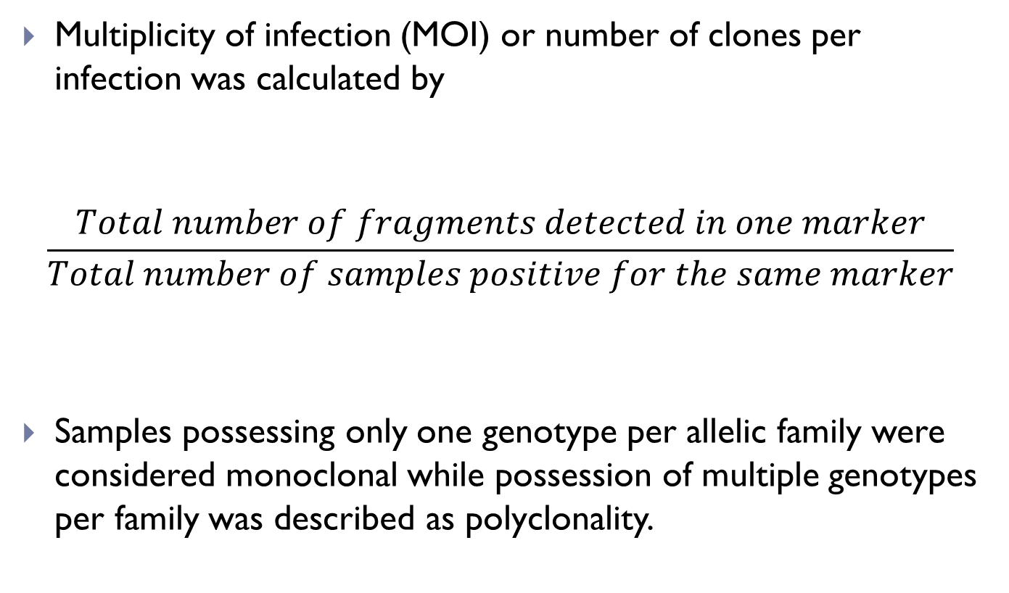
1. Multiplicity of Infections
POPULATION GENETIC ANALYSES
Multiplicity of infection (MOI) or number of clones per infection was calculated by
$$\frac{Total number of fragments detected in one marker}{Total number of samples positive for the same marker}$$
Samples possessing only one genotype per allelic family were considered monoclonal while possession of multiple genotypes per family was described as polyclonality.

Slide 27
2. Genetic diversity
Genetic diversity was calculated for each of the microsatellite loci based on the allele frequencies, using the formula for expected heterozygosity,
H_{E} = [(n/n−1) (1−∑p2)],
  n is the number of isolates analyzed
  p represents the frequency of each different allele at a locus.
  H_{E} provides an indication of the probability that two individuals will be different.
  It has a potential range from 0 (no allele diversity) to 1 (all sampled alleles are different).

Slide 28
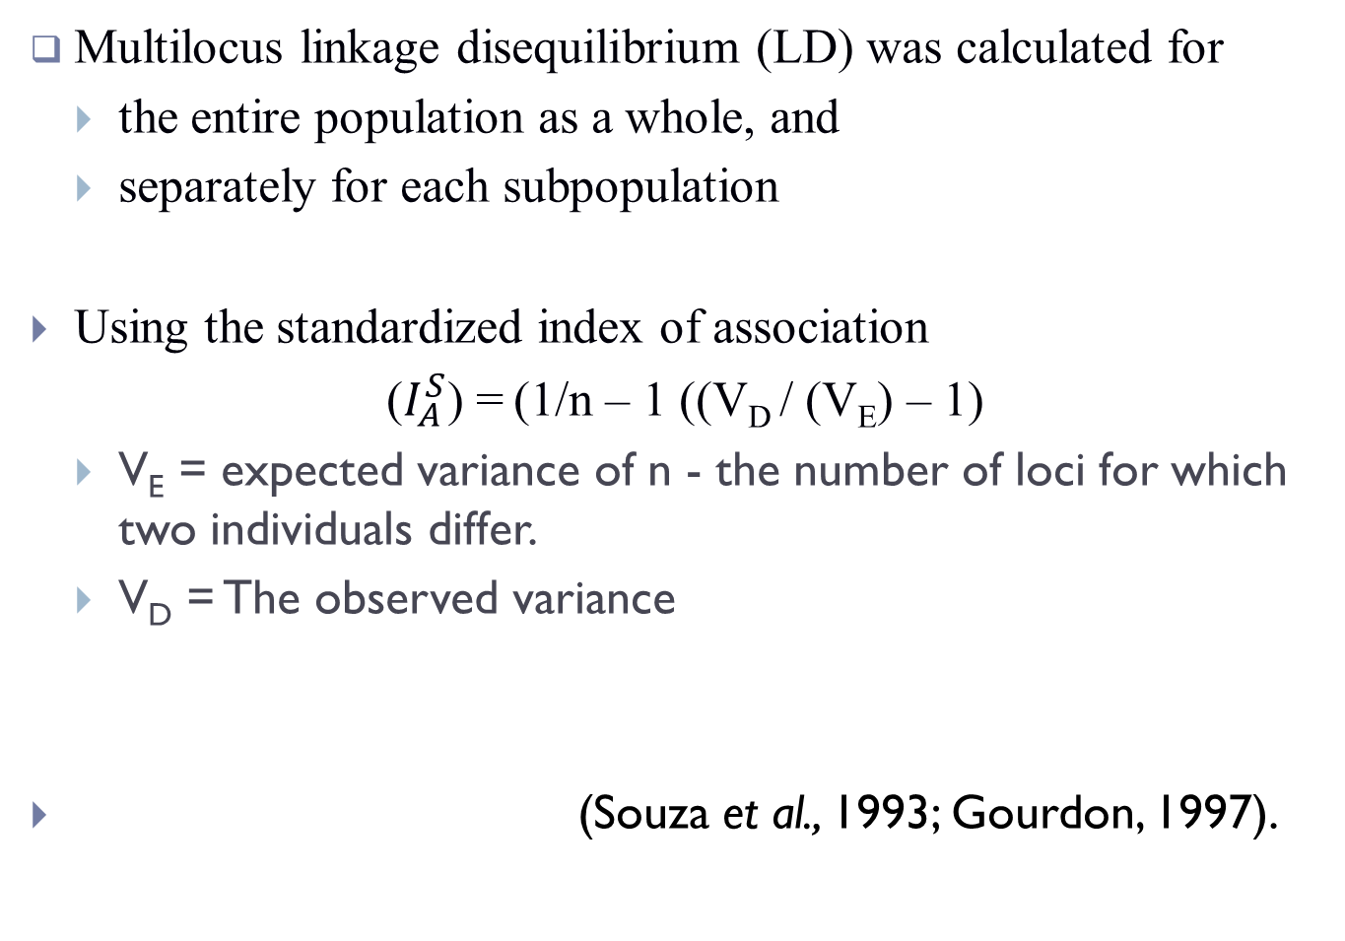
3. Linkage disequilibrium
Multilocus linkage disequilibrium (LD) was calculated for
  the entire population as a whole, and
  separately for each subpopulation
Using the standardized index of association
($I_{A}^{S}$) = (1/n – 1 ((V_{D} / (V_{E}) – 1)
  V_{E} = expected variance of n - the number of loci for which two individuals differ.
  V_{D} = The observed variance
(Souza et al., 1993; Gourdon, 1997).

Slide 29
4. Analysis of population differentiation
Between population and within population variance was determined with analysis of molecular variance (AMOVA), (ΦPT).
ΦPT is an analogue of Wright’s Fst useful for making inferences about the evolution of microsatellites (Excouffier et al., 1992).
ΦPT = 0-0.05 was considered indicative of no genetic difference among populations. ΦPT> 0.05 was considered indicative of high genetic differentiation
A distance between isolates from the different populations was estimated in GENALEX 6 (Peakall and Smouse, 2006).
Population structure was visualized in an R-dot plot of coordinates 2 and 3.

Slide 30
Bioinformatic pipeline analyses
Sequence reads from Ion PGM
UBUNTU/LINUX OS
Mapping of sequences using Burrows-Wheeler’s Aligner (BWA)
SAM Tools
Sorted BAM file
BAM file
Reference P. falciparum sequence from PlasmoDB
Sorting of reads
BCF tools
SNP annotation
Final SNPs (variants)
snpEff
SNP filtering
Variant calling
BCF tools
WHAMM
DnaSP 5.1
Syn and Non-syn polymorphisms
Tajima’s D
Integrated Haplotype score

Slide 31
1. Quality filtering and SNP annotation
A filter to rule out error-prone variant calls, based on a pseudo Phred Q-score
A Q30 (i.e one error per one-thousand bases) filter was used
The reading frame and exon boundaries were determined from the PlasmoDB 13.0 annotation of the 3D7 genome (www.plasmodb.org) using snpEff software

Slide 32
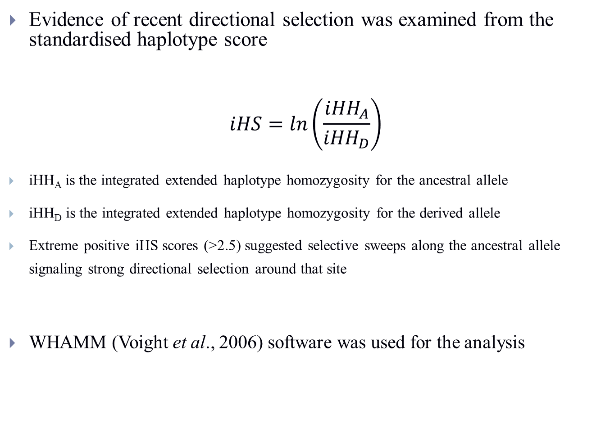
2. Integrated Haplotype Score (iHS)
Evidence of recent directional selection was examined from the standardised haplotype score
$$iHS=ln\left(\frac{{iHH}_{A}}{{iHH}_{D}}\right)$$
  iHH_{A} is the integrated extended haplotype homozygosity for the ancestral allele
  iHH_{D} is the integrated extended haplotype homozygosity for the derived allele
  Extreme positive iHS scores (>2.5) suggested selective sweeps along the ancestral allele signaling strong directional selection around that site
WHAMM (Voight et al., 2006) software was used for the analysis

Slide 33
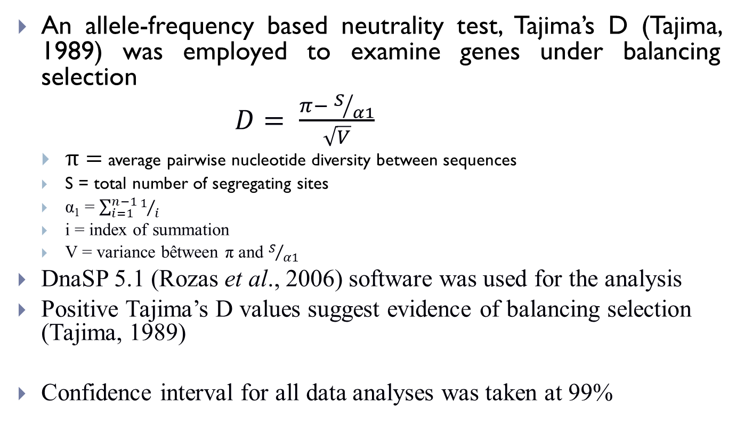
3. Tajima’s D test
An allele-frequency based neutrality test, Tajima’s D (Tajima, 1989) was employed to examine genes under balancing selection
$D= \frac{π− S/{α1}}{\sqrt{V}}$
  $π=$average pairwise nucleotide diversity between sequences
  S = total number of segregating sites
  α₁ = $\sum_{i=1}^{n−1}{1/i}$
  i = index of summation
  V = variance bêtween π and $S/{α1}$
DnaSP 5.1 (Rozas et al., 2006) software was used for the analysis
Positive Tajima’s D values suggest evidence of balancing selection (Tajima, 1989)
Confidence interval for all data analyses was taken at 99%

Slide 34
RESULTS

Slide 35
Objective 1
Determine the allelic variants, clonal distribution and multiplicity of infections with P. falciparum

Slide 36
Table 4: Profile and prevalence of malaria among study participants
Profile | STUDY AREAS
 | Lekki (LEK) | Aramoko-Ekiti (AMK) | Badagry (BDG)
Participants screened for uncomplicated malaria | 564 | 1309 | 784
Microscopically confirmed cases of P.falciparum infection | 125 | 504 | 205
Prevalence (%) | 22.1 | 38.5 | 26.1
Male | 52 | 124 | 68
Female | 73 | 380 | 137
Age range in years (Mean) | 2-37 (20.5±3.4) | 2-76 (34.4 ± 10.5) | 2-54 (28.7± 8.6)

Slide 37

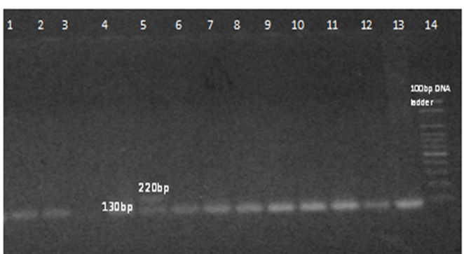

Lane 1: 100bp DNA ladder
“ 2: NTC
3,4,5,8,9,10,11,12,13,15: Infections with two K1 clones
6,7,14: Infections with no K1 clones
Lane1,2,4,5-13: Infections with single MAD20 clones
Lane 3: Infection with two MAD20 clones
Plates 1 – 2: Gel photo-documentation indicating the different clones of the MSP 1 marker

Slide 38
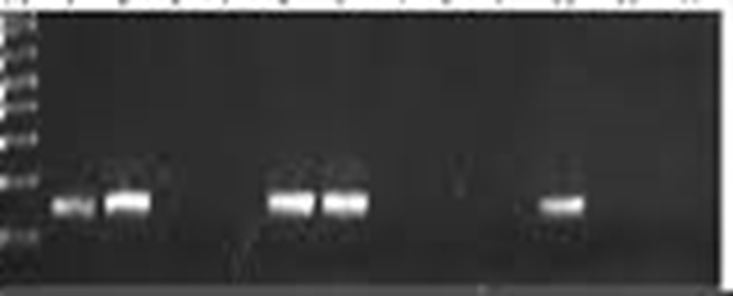
Plate 3: Gel photo-documentation indicating the different clones of the RO33 marker
1 | 2 | 3 | 4 | 5 | 6 | 7 | 8 | 9 | 10 | 11 | 12 | 13 | 14
Lane 1: 100bp DNA ladder
Lane 2: RO33 Positive control
Lanes 4,5,8,9,10 and 13: Infections with no RO33 family
Lanes 2,3,6,7 and 11:: Infections with RO33 family (160bp)
Lane 14: No template control

Slide 39

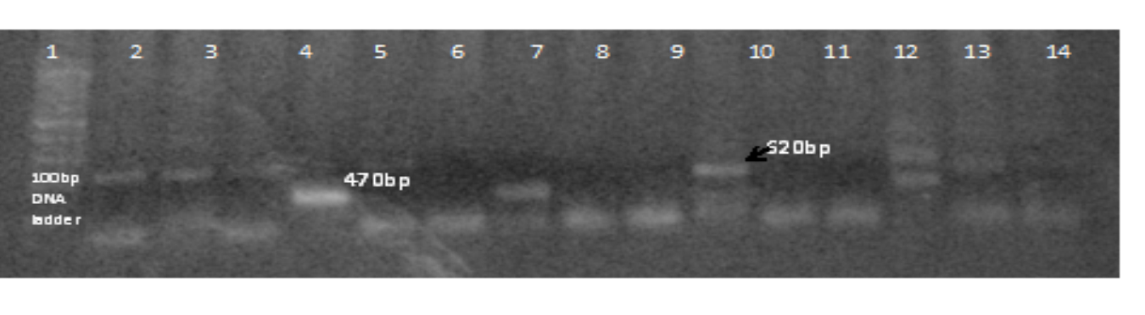

Lane 1: 100bp DNA ladder
Lane 2: 610bp FC27 clone
Lanes 3 and 13: 400bp FC27 clones only
Lanes 7 and 11: 400bp and 500bp clones
Lane 6: 500bp and 700bp clones
Lane 10: 500bp and 600bp clones
Lane 12: 500bp only
Lane 1: 100bp DNA ladder
Lanes 2,3,4 and 15: 520bp 3D7 clones only
Lanes 12 and 15: 470bp and 520bp 3D7 clones
Plates 4 and 5: Gel photo-documentation indicating different clones of MSP2 antigenic marker

Slide 40
Table 5: Allelic variants and clonal diversity of parasite isolates from the study areas
Markers |  |  |  | LEK | BDG | AMK
MSP1
 | K1 | (%) |  | 70 | 50 | 80
 |  | Genotypes |  | 2 | 3 | 3
 | MAD20 | (%) |  | 50 | 50 | 70
 |  | Genotypes |  | 2 | 2 | 3
 | R033 | (%) |  | 50 | 40 | 84
 |  | Genotypes |  | 1 | 1 | 1
MSP2
 | FC27 |  | (%) | 94 | 30 | 76
 |  |  | Genotypes | 3 | 1 | 4
 | 3D7 |  | (%) | 70 | 40 | 54
 |  |  | Genotypes | 2 | 2 | 3
MOI |  |  |  | 1.37 | 1.29 | 1.75

Slide 41
Figure 3: Frequency of MSP1 infections

Slide 42
Figure 4: Frequency of MSP2 families

Slide 43
Figure 5: Multiplicity of infections by age groups

Slide 44
Objective 2
Determine the population structure of P. falciparum isolates

Slide 45
Microsatellite genotyping
Table 6 Allele sizes and frequencies of Poly α and PFPK2
Locus | Allele | Lekki (Frequency) | Badagry (Frequency) | Aramoko-Ekiti (Frequency)
Poly α | 107 | 0 | 0.06 | 0.07
 | 110 | 0 | 0 | 0.02
 | 113 | 0.1 | 0.06 | 0.02
 | 116 | 0 | 0.24 | 0.12
 | 119 | 0.3 | 0.24 | 0.24
 | 122 | 0.5 | 0.12 | 0.27
 | 125 | 0.1 | 0.06 | 0.10
 | 128 | 0 | 0.12 | 0.10
 | 131 | 0 | 0 | 0.02
 | 134 | 0 | 0.06 | 0.02
 | 172 | 0 | 0.06 | 0
PFPK2 | 154 | 0 | 0.07 | 0
 | 157 | 0 | 0.07 | 0
 | 160 | 0.13 | 0.13 | 0.05
 | 163 | 0.25 | 0.27 | 0.23
 | 166 | 0 | 0.27 | 0.23
 | 169 | 0.25 | 0.07 | 0.29
 | 172 | 0.38 | 0.07 | 0.05
 | 175 | 0 | 0 | 0.08
 | 178 | 0 | 0 | 0.05
 | 181 | 0 | 0 | 0.05
 | 184 | 0.13 | 0.07 | 0.03
 | 187 | 0 | 0 | 0.05
 | 278 | 0 | 0 | 0.03

Slide 46
Table 7: Allele sizes and frequencies of TA81 and ARA2
Locus | Allele | Lekki (Frequency) | Badagry (Frequency) | Aramoko-Ekiti (Frequency)
TA81 | 120 | 0 | 0 | 0.01
 | 141 | 0 | 0 | 0.01
 | 144 | 0 | 0 | 0.01
 | 147 | 0 | 0 | 0.01
 | 150 | 0 | 0 | 0.03
 | 153 | 0 | 0.07 | 0.03
 | 156 | 0.11 | 0.14 | 0.28
 | 159 | 0.22 | 0.14 | 0.22
 | 162 | 0.22 | 0.14 | 0.14
 | 165 | 0 0.22 | 0 | 0.08
 | 168 |  | 0.21 | 0.06
 | 171 | 0.11 | 0.14 | 0.03
 | 174 | 0.11 | 0 | 0.08
 | 177 | 0 | 0.14 | 0
 | 180 | 0 | 0 | 0.11
ARA 2 | 50 | 0 | 0.06 | 0.04
 | 53 | 0 | 0.12 | 0
 | 65 | 0.63 | 0.12 | 0.19
 | 68 | 0.25 | 0.18 | 0.26
 | 71 | 0.125 | 0 | 0.13
 | 74 | 0 | 0 | 0.02
 | 77 | 0 | 0 | 0.02
 | 80 | 0 | 0 | 0.04
 | 86 | 0 | 0.12 | 0.02
 | 89 | 0 | 0.06 | 0
 | 110 | 0 | 0.35 | 0.28

Slide 47
Table 8: Allele sizes and frequencies of TA40 and TA42
Locus | Allele | Lekki (Frequency) | Badagry (Frequency) | Aramoko-Ekiti (Frequency)
TA 40 | 63 | 0 | 0.06 | 0
 | 81 | 0 | 0 | 0.02
 | 90 | 0 | 0 | 0.02
 | 96 | 0 | 0.13 | 0.02
 | 99 | 0.11 | 0.06 | 0.17
 | 102 | 0.11 | 0.31 | 0.14
 | 105 | 0.22 | 0.19 | 0.21
 | 108 | 0.11 | 0 | 0.14
 | 111 | 0.44 | 0 | 0.12
 | 114 | 0 | 0.06 | 0.10
 | 117 | 0 | 0.06 | 0
 | 120 | 0 | 0.13 | 0.05
TA 42 | 161 | 0.29 | 0.17 | 0.13
 | 164 | 0.14 | 0.17 | 0.09
 | 167 | 0 | 0.33 | 0.09
 | 170 | 0.29 | 0 | 0.30
 | 173 | 0 | 0.33 | 0.04
 | 176 | 0.29 | 0 | 0.04
 | 179 | 0 | 0 | 0.04
 | 182 | 0 | 0 | 0.09
 | 185 | 0 | 0 | 0.04
 | 188 | 0 | 0 | 0.09
 | 191 | 0 | 0 | 0.04

Slide 48
Table 9: Allele sizes and frequencies of 2490 and TA 60
Locus | Allele | Lekki (Frequency) | Badagry (Frequency) | Aramoko-Ekiti (Frequency)
2490 | 62 | 0.83 | 0.83 | 0.3
 | 186 | 0.17 | 0.17 | 0.6
 | 201 | 0 | 0 | 0.05
 | 246 | 0 | 0 | 0.05
TA 60 | 67 | 0 | 0.19 | 0.29
 | 94 | 0 | 0.06 | 0.05
 | 97 | 0.38 | 0.25 | 0.19
 | 100 | 0.50 | 0.50 | 0.45
 | 103 | 0.13 | 0 | 0
 | 106 | 0 | 0 | 0.02

Slide 49
Table 10: Allele sizes and frequencies of TA109 and PFG377
Locus | Allele | Lekki (Frequency) | Badagry (Frequency) | Aramoko-Ekiti (Frequency)
TA 109 | 156 | 0.17 | 0 | 0
 | 159 | 0.05 | 0 | 0
 | 162 | 0 | 0.18 | 0.18
 | 165 | 0 | 0.12 | 0.18
 | 171 | 0 | 0.06 | 0
 | 174 | 0.33 | 0.12 | 0.18
 | 177 | 0.33 | 0.12 | 0.16
 | 180 | 0 | 0 | 0.07
 | 186 | 0 | 0 | 0.02
 | 189 | 0.17 | 0 | 0
 | 198 | 0 | 0.41 | 0.22
PFG377 | 76 | 0.25 | 0.27 | 0.22
 | 79 | 0 | 0.33 | 0.22
 | 82 | 0 | 0 | 0.06
 | 85 | 0.38 | 0.27 | 0.25
 | 88 | 0.13 | 0.13 | 0.25
 | 94 | 0.13 | 0 | 0
 | 97 | 0.13 | 0 | 0

Slide 50
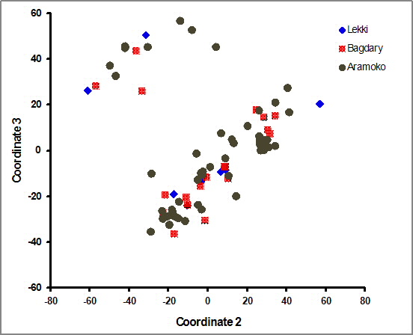
Figure 7: Population structure of P. falciparum isolates from southwestern Nigeria: Principal coordinate analysis (PCoA) from allelic variance at 10 haploid microsatellite loci. (Coordinates 2 and 3 in the PCoA show limited sub-structuring of P. falciparum isolates into two clusters not determined by site)

Slide 51
Table 11: Assessment of the genotypes of each isolate
Locality | Isolates with given number of genotypes |  |  |  | Mean number of genotypes
 | 1 | 2 | 3 | 4
LEK | 4 | 6 | 0 | 0 | 1.60
BDG | 9 | 5 | 1 | 1 | 1.59
AMK | 18 | 18 | 5 | 0 | 1.66
Kruskal-Wallis test showed
no S.D (P > 0.01)

Slide 52
Table 12: Genetic diversity (H_{E}) of the parasites from the three populations
Locus | LEK | BDG | AMK
Poly α | 0.66 | 0.87 | 0.84
PfPK2 | 0.73 | 0.83 | 0.80
TA81 | 0.85 | 0.89 | 0.83
ARA II | 0.55 | 0.81 | 0.82
TA40 | 0.75 | 0.84 | 0.91
TA42 | 0.77 | 0.77 | 0.87
2490 | 0.30 | 0.30 | 0.56
TA60 | 0.62 | 0.73 | 0.68
TA109 | 0.49 | 0.75 | 0.83
PfG377 | 0.78 | 0.75 | 0.79
Mean | 0.65 | 0.75 | 0.79

Slide 53
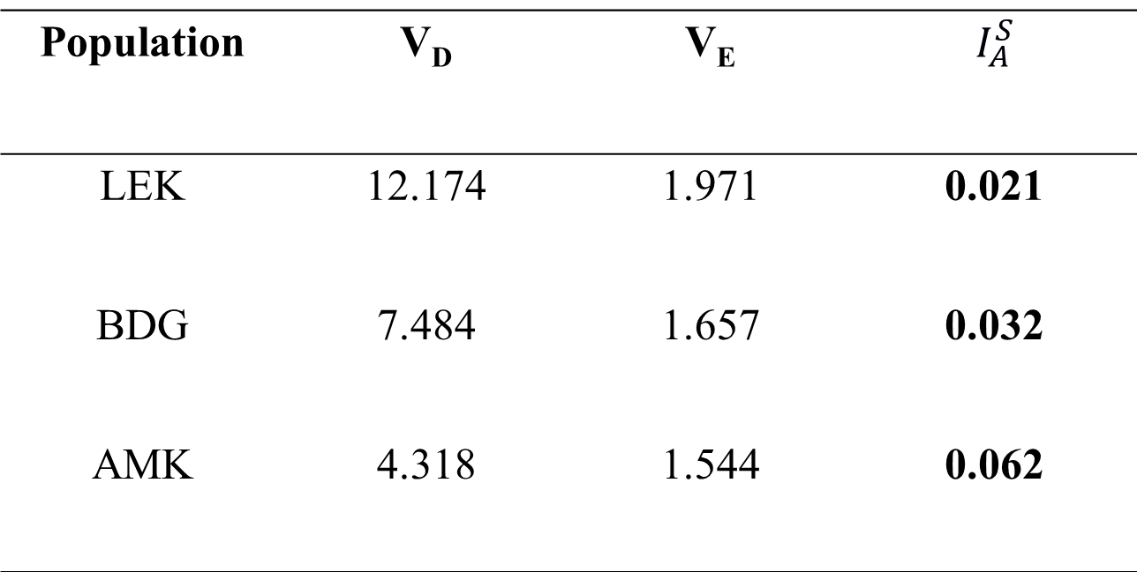
Table 13: Linkage disequilibrium analysis for each P. falciparum population
Population | V_{D} | V_{E} | $$I_{A}^{S}$$
LEK | 12.174 | 1.971 | 0.021
BDG | 7.484 | 1.657 | 0.032
AMK | 4.318 | 1.544 | 0.062
V_{E} is the expected variance of n - the number of loci for which two individuals differ. V_{D} = the observed variance

Slide 54
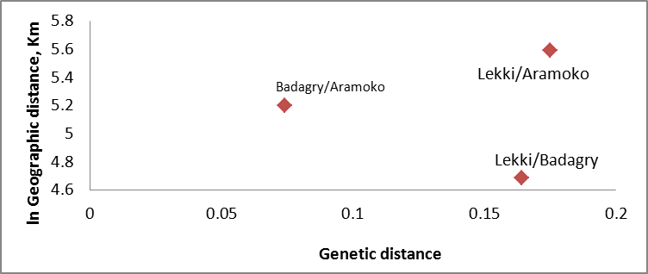
Figure 6: Relationship between geographic and genetic distances, (uD), for each pair of parasite populations studied. Genetic distance (x-axis) was determined using GENALEX 6.0 for each pair of populations separated by distance in kilometers (plotted on the y-axis in natural log scale).

Slide 55
Objective 3
Assess the extent of directional selection on genes associated with antimalarial drug resistance

Slide 56
Run summary
488 million bases were generated
Median read length of 182bp
5.7x mapping depth coverage (Table 13)
13, 784 single nucleotide polymorphisms (SNPs) were identified across the 14 chromosomes of the parasite genome
3, 122 genes were analysed after excluding hypervariable genes from the subtelomeric region (i.e stevor, var and rifin genes).

Slide 57
Figure 8: Snapshot of variant caller format (VCF) of mapped sequence reads

Slide 58
Table 14: Genome sequence summary
Length of non-gap regions covered by reads | 13226305
Length of 24bp unique regions of the reference | 264683
Reference nucleotide composition | A: 37.87%, C: 13.35%, G: 14.62%, T: 34.16%
Reads nucleotide composition | A: 36.07%, C: 15.71%, G: 17.71%, T: 30.51%
Average depth across all non-gap regions | 0.691
Average depth across 24bp unique regions | 0.514
Number of reference sequences | 132994
Length of reference sequences excluding gaps | 53277940
Length of gaps in the reference sequences | 1299037
Average coverage depth of reference sequence | 5.7x

Slide 59
Figure 9: Distribution of synonymous and nonsynonymous SNPs in known target genes of drug and immunity (CRT = Chloroquine resistant transporter; MDR = Multidrug resistant transporter; DHFR = dihydrofolate reductase; DHPS = dihydropteroate synthase; GDV = Gametocyte development; MSP = Merozoite surface protein; LSA = Liver stage antigen)

Slide 60
Table 15: Windows of directional selection for genomic regions with 2 or more SNPs and shared iHS score > 2.5
Chromosome | Window |  | Region size (kb) | Number of SNPs | Id of genes within region
 | Start | stop
1 | 163 | 184 | 21 | 4 | PF3D7_0103600 –PF3D7_0104200
2 | 302 | 515 | 213 | 1 | PF3D7_0210900 –PF3D7_0213600
4 | 407 | 585 | 178 | 2 | PF3D7_0409600 –PF3D7_0413300
5 | 822 | 1007 | 185 | 12 | PF3D7_0519800 –PF3D7_0524200
6 | 1039 | 1297 | 258 | 32 | PF3D7_0625100 –PF3D7_0630600
7 | 238 | 249 | 11 | 4 | PF3D7_0704550 –PF3D7_0704900
9 | 1060 | 1220 | 160 | 15 | PF3D7_0929320 –PF3D7_0930500
10 | 1210 | 1557 | 347 | 10 | PF3D7_1029500 – PF3D7_103880
11 | 1190 | 1310 | 200 | 8 | PF3D7_1132920 –PF3D7_1133600
12 | 1451 | 1880 | 429 | 6 | PF3D7_1234900 –PF3D7_1248500
13 | 303 | 358 | 55 | 3 | PF3D7_1306470 –PF33D7_130790
13 | 2410 | 2520 | 110 | 3 | PF3D7_1306470 –PF3D7_1307900
14 | 1910 | 1932 | 22 | 2 | PF37_1407000 – PF3D7_1447900

Slide 61
Objective 4
Identify target genes of immunity under balancing selection

Slide 62
Table 16: Target genes of acquired immunity showing high values of Tajima’s D
Gene ID | Chromosome no | Frequency of polymorphism π x 10 ⁻³ | Tajima’s D
MSP(DBLMSP2) | 10 | 27.9 | 2.58
CSP | 3 | 20.6 | 1.38
EBA-175 | 7 | 17.2 | 1.29
MSP7 | 13 | 13.5 | 0.84
MSP3 | 10 | 23.8 | 0.73
SERA5 | 2 | 24.1 | 0.21
MSPDBL2=Merozoite surface protein duffy binding-like; CSP = circumsporozoite protein; EBA = Erythrocyte-binding antigen; MSP = Merozoite Surface Protein; SERA = Serine repeat antigen

Slide 63
SUMMARY OF FINDINGS
On the basis of the objectives, the following was observed:
Objective 1 | Summary of findings
Determine the allelic variants, clonal diversity, multiplicity infections and genetic differentiation of P. falciparum in South-West Nigeria. | Few allelic variants leading to low clonal diversity Clonal diversity was highest in AMK and lowest in BDG Multiplicity of Infections (MOI) was highest among children 2-4 years old.

Slide 64
Objective 1 (cont’d) | Summary of findings
Determine the allelic variants, clonal diversity, multiplicity infections and genetic differentiation of P. falciparum in South-West Nigeria. | Low genetic differentiation between populations (ΦPT = 0.017) No substantial difference in the mean number of genotypes in the three parasite populations (P > 0.01) Multilocus linkage disequilibrium was low in all the study populations LD was highest in AMK isolates and lowest in LEK. Pairwise Nei genetic distances (uD) between LEK and BDG, LEK and AMK and BDG and AMK parasite populations, were 0.164, 0.175 and 0.074 respectively indicating no obvious relationship between genetic and physical distances between the study areas

Slide 65
Objective 2 | Summary of findings
Determine the population structure of P. falciparum isolates | Low-level of population sub-structuring of the parasite in the region Genetic diversity (H_{E}) was high in all the studied parasite populations No significant difference in the mean H_{E} values across all loci between LEK and BDG as well as BDG and AMK. The difference in the H_{E} values between LEK and AMK was significant.

Slide 66
Objective 3 | Summary of findings
Assess the extent of directional selection on genes associated with antimalarial drug resistance | Fourteen shared iHS regions that had at least 2 SNPs with a score > 2.5 were identified. Chloroquine resistance transporter (CRT) and multidrug resistant (MDR1) genes showed evidence of strong directional selection No evidence of selection in dihydrofolate reductase (DHFR); weak selection in dihydropteroate synthase (DHPS) and MDR5 genes.

Slide 67
Objective 4 | Summary of findings
Identify target genes of immunity under balancing selection | Frequency-based neutrality test (Tajima’s D) was negative for most of the genes. MSP3. MSP7, SERA-5 EBA-175, CSP and MSPDBL2 were the genes with the highest Tajima’s D values

Slide 68
CONTRIBUTIONS TO KNOWLEDGE
This investigation has identified MSP3, MSP7, SERA-5 EBA-175, CSP and MSPDBL2 as potential target antigens of host immunity which can serve as vaccine candidates.
The study shows that CRT and MDR1 genes associated with resistance of P. falciparum to CQ are under drug pressure, hence the re-introduction of CQ will be inappropriate.
There is no genetic evidence to show that DHFR and DHPS genes are under strong selection pressure therefore use of SP for chemoprophylaxis should not be discontinued despite resistance concerns.

Slide 69
CONTRIBUTIONS TO KNOWLEDGE (Cont’d)
4. The study has shown low diversity and multiplicity of
  P. falciparum infections pointing to reduction in transmission intensity which indicate that the present malaria interventions may be yielding results.
5. The study has revealed low-level of genetic differentiation
  of P. falciparum parasites in southwestern Nigeria demonstrating that uniform chemotherapeutic and vaccinological approaches can be adopted for the region.

Slide 70
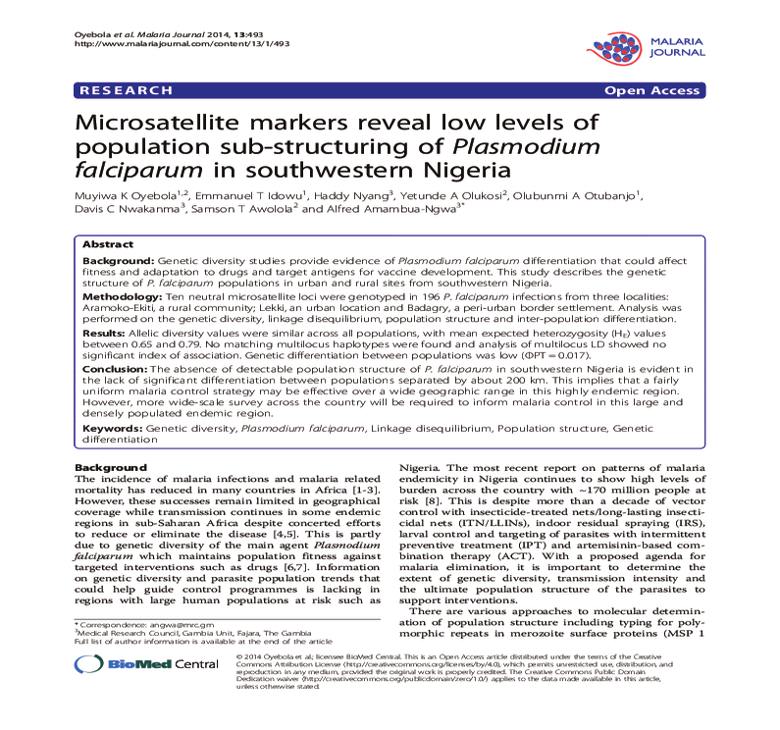

Slide 71



Acknowledgements
University of Lagos
Nigerian Institute of Medical Research, Lagos
Medical Research Council (MRC), Fajara, The Gambia
St Kizito’s Catholic Clinic, Lekki, Lagos State
Ajara PHC, Badagry, Lagos State
Aramoko General Hospital, Ekiti State

Slide 72
THANK YOU

