Slide 1


OVERVIEW OF STUDENTS ACADEMIC MATTERS IN UNIVERSITY OF LAGOS

Slide 2

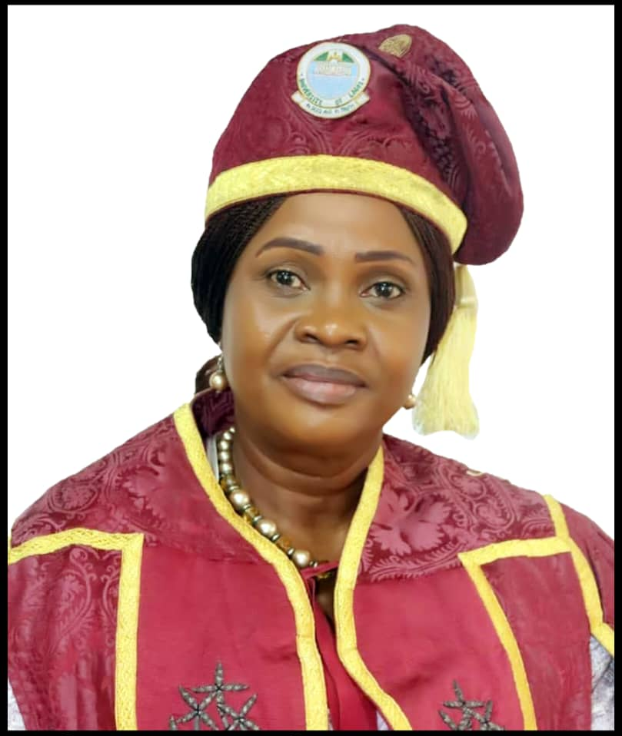
OLAKUNLE E.MAKINDE (MRS.)
MNIM
Ag. REGISTRAR,
UNIVERSITY OF LAGOS
AUGUST 23, 2023

Slide 3
Learning Objectives:
At the end of the session, participants will be able to:
effectively take decisions in line with University Senate-approved policies;
ensure compliance with Senate-approved academic regulations in the University by both students and staff; and
guide the Faculty/Department members in implementing all Senate decisions.

Slide 4
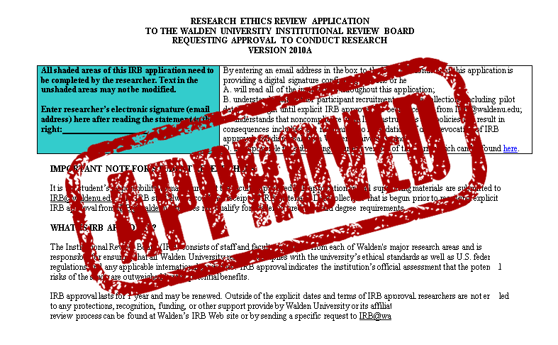
Directorate of Academic Affairs
Smooth administration of students matters
Ensuring compliance with Senate-approved academic regulations in the University by both students and staff
Implementing all Senate decisions
This Photo by Unknown author is licensed under CC BY-NC-ND.

Slide 5
Directorate of Academic Affairs
Academic Affairs Unit
Admissions’ Unit
Records’ and Certificates/Verification Unit
Senate and Ceremonies Unit
Examinations’ Unit
The Directorate is made up of:

Slide 6

Directorate of Academic Affairs
The Directorate of Academic Affairs is charged with the responsibility of ensuring:
Smooth administration of students matters.
Ensuring compliance with Senate-approved academic regulations in the University by both students and staff.
Implementing all Senate decisions.

Slide 7

Policies on Studentship
Registration
Deferment, Leave of Absence and Medical/Sick Leave
Re-Absorption of Students after Deferment /Leave of Absence and Withdrawal due to absence
Extension of Studentship

Slide 8

Policies on Studentship
Withdrawal
Termination of Programme/Conditions Guiding Re-Admission into undergraduate programme
Senate-Approved Penalties Academic/Social Misconduct
Suspension and Rustication
Re-Admission after Rustication

Slide 9
Policies on Studentship
Inter/Intra Faculty Transfer
Policy on Change of Name
Policy for the Conduct of Examinations for Visually Impaired Students
Disposal of Old Examination Scripts

Slide 10
Registration Cont’d
Every student is expected to register at the commencement of every semester
All students print two copies of their Course Registration Forms for endorsement by their respective Course-Advisers, within the 6th and 7th week of resumption for the semester

Slide 11
Registration
Cont’d
All Students and Departments are to keep a copy (each) of the endorsed form
Registration for courses within the stipulated period as approved by the Senate on Academic Calendar is compulsory
Courses not registered for cannot be credited with scores (grades).

Slide 12
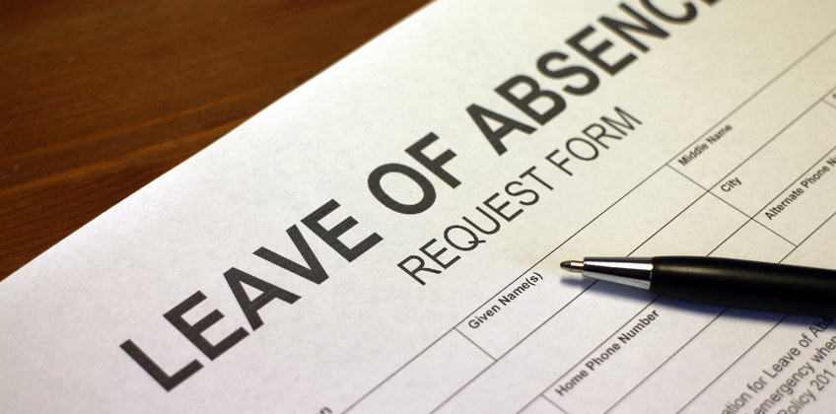
Deferment, Leave of Absence and Medical/Sick Leave
Leave of Absence (LoA):a request made at the beginning of the session, before registration
Deferment: a request made after registration, before Semester examination
It is important to note that:
Fully registered students are eligible to apply for deferment within the Semester
Students who are unable to register for a particular Semester or Session are eligible to apply for Leave of Absence (LoA).

Slide 13

Deferment, Leave of Absence and Medical/Sick Leave
Retroactive Leave of Absence and Deferment do not exist.
Results of students are processed as ABSENT at the end of Semester if they are not registered.
Courses registered, for which examinations are not taken, are credited with Zero (F) grades.

Slide 14
Procedure
Request for Leave of Absence/Deferment of 1 or 2 Semesters is considered and approved at the Faculty by the Dean or Director of Distance Learning Institute
Request for Leave of Absence/Deferment of 3 Semesters and above are considered and recommended by the Faculty Board of Studies to Senate through Academic Affairs. presented in the Senate-approved format:
S/No | Matric. No | Name | Level | Last CGPA | Academic Status | TCUO | Semesters Absent | Reason | Remark

Slide 15

Medical/Sick Leave
Absence from examination due to medical reason should be processed through the Director of Medical Services for endorsed medical report within 72hours or forfeit endorsement.

Slide 16
Procedure
A student seeking sick leave will submit an application letter along with the medical report endorsed by the Director of Medical Services through the Faculty/Department to Academic Affairs
Result broadsheets of such student should be marked as ‘SICK’ for the examinations not taken following approval by the Vice Chancellor
If the result of such a student has been approved by the University Senate, the Department will seek amendment of results of courses affected through the Business Committee of Senate (BCOS)

Slide 17
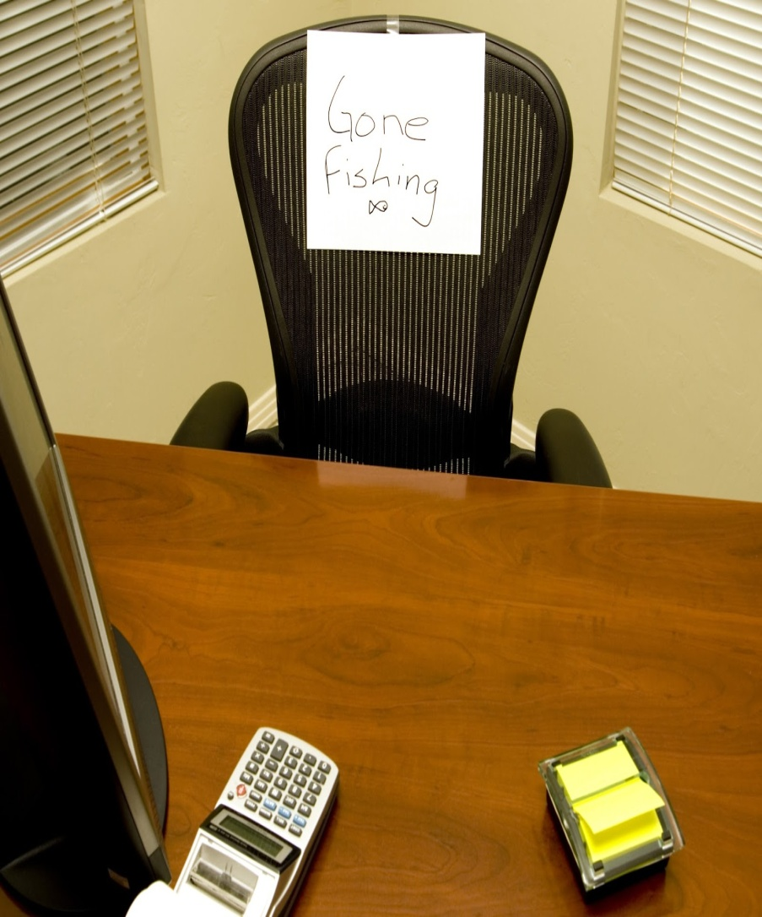
Re-Absorption of Students after Deferment/Leave of Absence and Withdrawal due to absence
Students are re-absorbed at the expiration of period of deferment, leave of absence and re-instatement of studentship by Senate, following withdrawal due to three or more Semesters’ absence.

Slide 18
Procedure
Re-absorption after deferment and LoA is handled at the Faculty level, re-absorption after withdrawal due to three or more Semesters absence is considered by the University Senate as processed by the Academic Affairs’ Office through the Business Committee of Senate
Re-absorption after withdrawal due to three or more Semesters absence are considered and recommended by the Faculty Board of Studies to Senate through the Director, Directorate of Academic Affairs, presented in the approved format
The maximum number of Semesters approved by Senate to be eligible for re-absorption is Six Semesters

Slide 19

Extension of Studentship
Premier automatically suspends the online account of any student whose studentship expires. Every student is entitled to two additional Sessions to complete their programme. This means:
Three year programme, 2 extra Sessions - 5 Sessions
Four year programme, 2 extra Sessions - 6 Sessions
Five year programme, 2 extra Sessions - 7 Sessions

Slide 20
Procedure
I. At expiration of studentship, students apply for Extension through Course Adviser, Head of Department and Dean to the Director Academic Affairs.
II. Application for Extension of Studentship is processed to BCOS for consideration and recommendation to Senate for approval.
III. Senate decision is conveyed to the student just as the student’s online profile is endorsed.

Slide 21

Withdrawal
i) Absence from academic activities for 3 consecutive Semesters
ii) A 1st Year (100 Level: UTME or 200 Level: Direct Entry) student with a GPA of less than 1.00 for 2 consecutive Semesters
iii) A student with a GPA of less than 1.00 for 3 consecutive Semesters

Slide 22
Withdrawal Cont’d
The students in the last two (2) categories above are asked to withdraw from the University. However, there is a peculiarity with the CMUL/Pharmacy students, whereby students with GPA of less than 2.40 are asked to withdraw from the programme and NOT from the University.

Slide 23
Termination of Programme & Re-Admission
Students withdrawn based on poor academic performance could return (fresh admission) on condition that fresh admission shall not be sought into the same programme/course.
Students currently running a programme but who may wish to change to another programme through a fresh admission process may do so provided the previous programme is terminated at the point of registration for the new programme.
Students withdrawn based on Absence status could return on condition that the fresh admission shall be for a new programme/course different from the former programme/course.

Slide 24
Termination of
Programme
&
Re-Admission
Students on any form of penalty must serve the penalty (Social or Academic Misconduct: Rustication, Suspension) before they can be considered under category i, ii or iii above.
Any student expelled from the University CANNOT be offered fresh admission.
On a fresh admission, all courses previously taken are null and void.
The policy is made available on the University website, during advertisement for Post-UTME and in the Joint Admissions and Matriculation Board (JAMB) Brochure for candidates’ awareness.

Slide 25

Suspension and Rustication
Rustication is as indicated on the Senate approved penalties of Academic/Social Misconduct
Suspension: A student is suspended following his or her failure to appear before a misconduct panel. Suspension for 2 Semesters is issued after which non-appearance leads to Expulsion.
Re-Admission after Rustication
A student who has served out the period of rustication (as sanction for academic or social misconduct) needs to apply for re-admission into the University

Slide 26
Procedure
Application for re-admission is made to the Director, Academic Affairs by the student at the end of his or her rustication period.
Re-admission letter is issued by the Head, Examinations Unit.
However, for social misconduct, the Director must be satisfied that the student is repentant before being re-admitted. Thereafter, a letter of re-admission by the Head, Examinations Unit is issued to the student.

Slide 27
Policy on Change of Name
Request from female students only, should only be for surname;
The change of name must have predated the application for admission at either undergraduate or postgraduate level;
Production of sworn affidavit and newspaper publications; and
The date of birth and other names must be consistent.
All recommendations for change of name should be forwarded to the Registrar for approval before the change is implemented. Similarly, all other applications by current students for name change should not be entertained except on reasons of marriage, with other names being consistent.

Slide 28

Conduct of Examinations for Visually Impaired Students
Any visually impaired student, who is unable to write examination conventionally, must prior to admission in the University of Lagos, be able to use a Braille typewriter or Braille Laptop.
Examination questions should be provided in Braille, or questions be pre-recorded in audio formats for use by each student.
There should be no use of reader/helpers during examinations.

Slide 29
Conduct of Examinations for Visually Impaired Students
An extra time of fifteen (15) minutes in an hour paper may be allotted for their examinations.
Special Examination Centre may be provided for this category of students to minimize distractions.
The production of the examination questions in Braille or audio mode and safe keeping shall be domiciled with the Registrar.

Slide 30

Disposal of Old Examination Scripts
Deans of Faculty, Directors and Heads of Academic Departments/Units are reminded that the extant policy which stipulates that examination scripts be kept for ten (10) years subsists.
Examination scripts can only be disposed of centrally by the Directorate of Academic Affairs. To this end, Deans of Faculty, Directors and Heads of Academic Department/Unit who intend to dispose of examination scripts which had been kept for more than ten (10) years should forward same to the Director of Academic Affairs.

Slide 31
INTER/ INTRA FACULTY TRANSFER
Procedure:
Applicant must have completed year two (2) of the programme of admission.
Applicant must have a CGPA of not less than one (1.00) at the end of 2nd Semester, Year 2.
Relevant WAEC/NECO ‘O’ level results are required.
Application Form must have been approved by HoD and Dean of current and proposed Departments and Faculties.

Slide 32

Transfer of GST Courses (Results and Units)
Transferred and Re-assigned (Pre-Med.) students of the University do not need to re-take GST Courses already passed. The units of passed GST Courses are credited to each student.
Similarly, students offered fresh admission (Direct Entry) after completing a first degree programme in the University do not need to register for GST Courses already passed in the previous programme. However, they must fulfil the total number of units required for graduation in the new programme.

Slide 33

CONCLUSION
The University’s Vision and Mission Statements place emphasis on Learning and Character.
VISION: “To be a top class institution for the pursuit of excellence in knowledge, character and service to humanity”
MISSION: “To provide a conducive teaching, learning, research and development environment, where staff and students will interact and compete effectively with their counterparts, both nationally and internationally in terms of intellectual competence and the zeal to add value to our World
As leaders and decision makers in the various sectors of the university, it is imperative that we make these our watch words in all our undertakings in building the nation’s human capacity.

Slide 34

Thank you for Listening
Questions/
Comments

