Slide 1

Principles of Good Governance and Ethics in the Workplace
  Prof Obinna L. Chukwu FNES
  Deputy Vice Chancellor (Management Services)
  University of Lagos
  Training For Deans, Designated Directors, Heads Of Department & Deputy Registrars
  22nd -23rd August, 2023

Slide 2





Housekeeping and Climate Setting

Slide 3

Definition of Governance:
“The need for governance exists anytime a group of people come together to accomplish an end”.
Governance refers to all processes of governing, the institutions, processes and practices through which issues of common concern are decided upon and regulated.
Governance determines who has power, who makes decisions, how other players make their voice heard and how account is rendered.

Slide 4

Principles of Good Governance:
Legitimacy and Voice
  Participation, consensus orientation
Direction
  Strategic Vision
Performance
  Responsiveness, Effectiveness, Efficiency
Accountability
  Accountability and Transparency
Fairness
  Equity and rule of law

Slide 5
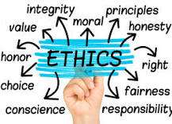
Principles of Ethics
Ethics are the principles that guide us to make a positive impact through our decisions and actions.
Workplace ethics are the set of values, moral principles, and standards that need to be followed by both employers and employees in the workplace.

Slide 6
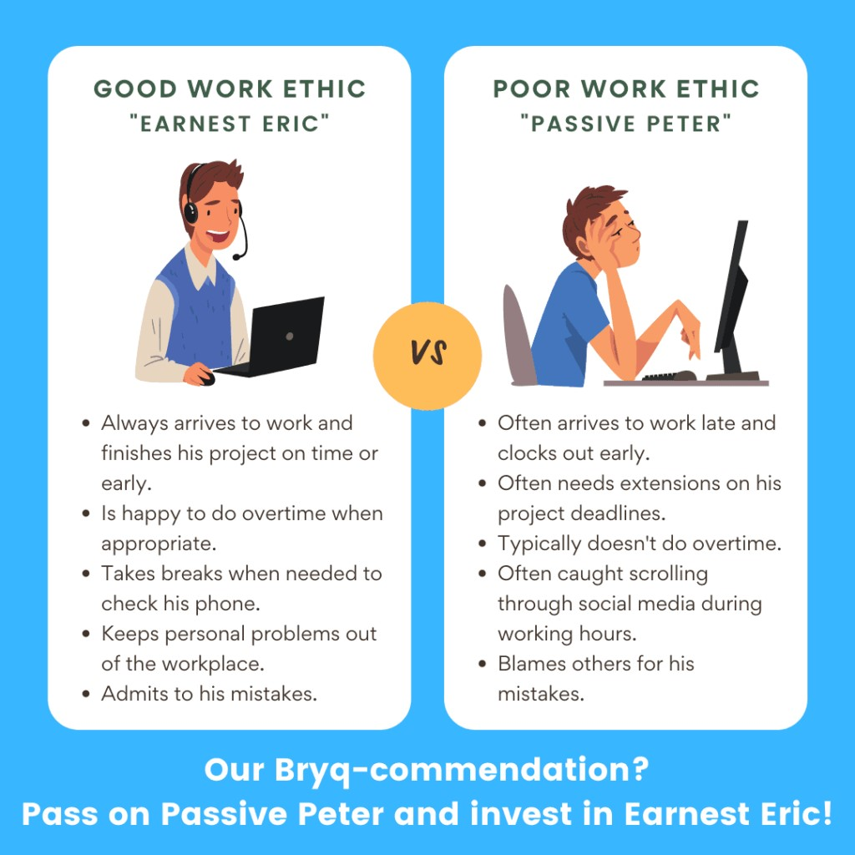
Good vs Bad Workplace Ethics

Slide 7
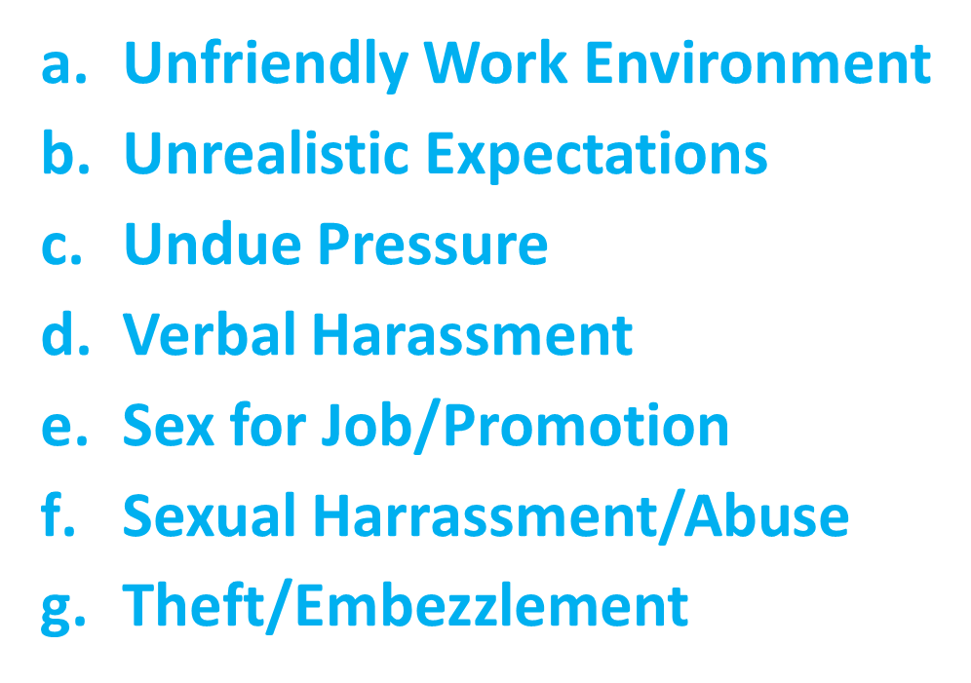
Ethical vs Unethical Behaviors in The Workplace
Develop Professional Relationships
Communicate Effectively
Compliance with Rules & Regulations
Take Responsibility
Maintain Professional Standards
Be Accountable
Respect Your Colleagues
Ethical
Unethical issues-set rules, accept feedback/complaints, spell out consequences, take disciplinary action following due process.

Slide 8
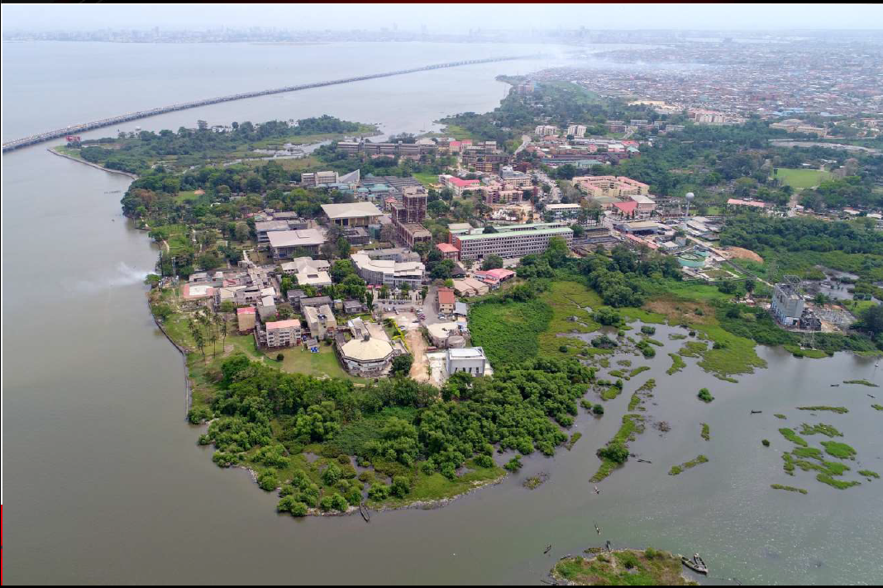
Our Workplace
UNILAG overlooks the Lagos Lagoon giving the main campus a scenic view.
The economic activities around the city presents countless opportunities for teaching, learning and research.
Green Campus

Slide 9
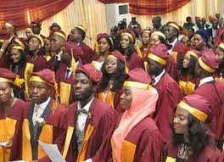







Our Workplace : Statistics
GENDER DISTRIBUTION FOR ALL STUDENTS
ALL STUDENTS
62,215
FEMALE
MALE
12
FACULTIES
48.5%
51.5%
Full time: 40,481
DLI=12,443
STUDENTS CATEGORIES
STUDENTS’ ENROLMENT (%)
6
INSTITUTES
WORLD UNIVERSITY RANKING
400-500
BACHELORS DEGREE
DISTANCE LEARNING
57%
20%
POST-GRADUATE DEGREE
OTHERS
15%
8%
STAFF
Academic =1,650
Male 606 Female 1,103
Non Teaching =3,253
Male 1,986 Female=1267
ACADEMIC PROGRAMMES
267
CENTRES
88
Undergraduate Programs
129
Postgraduate
Programs

Slide 10
University Governance Architecture -Laws
Laws establishing the University
There are a set of laws governing the establishment and management of the University of Lagos. These legislations determine the University's institutional and governance architecture.
    The University of Lagos Act Cap U9 Laws of the Federation of Nigeria 2004 (enacted in 1967) (“the Primary Legislation”)
    The Universities (Miscellaneous Provisions) Act 1993 (“the Primary Legislation of General Application”) with Amendment Act 2003, 2012)
The Primary Legislation sets out,
  the various organs of the University (Council, Senate, Congregation and Convocation),
  the principal officers of the University (Chancellor, Pro-Chancellor, Vice-Chancellor, Deputy Vice-Chancellor, Registrar, Bursar, University Librarian),
  the scope of authority and powers of the respective organs and Principal Officers, supervision and discipline of staff and students.

Slide 11
University Governance
Visitor and Principal Officers
The Visitor to the University is the President of the Federal Republic of Nigeria.
University Council
The Council is the supreme governing authority of the University responsible for those policy decisions, general superintendence of the affairs of the University, and, in particular, the control of the property and expenditure of the University.
Senate of the University
The Senate of the University has responsibility to control and organise the academic activities of the University, admission and discipline of students.
Court of Governors College of Medicine Idiaraba, Lagos

Slide 12
University Governance
UNILAG Administration Support Units
The university core functions of Teaching, Research and Community services are supported by input from units that are managed by quality non-teaching staff, technical staff and technologist.
Some of those major administrative units include the; Registry, Bursary, Security unit, Fire Service, Works & Physical Planning department, Medical Centre, Sports Centre, Unions ASUU, SSANU, NAAT, NASU
Student Governance & Representation
UNILAG students run a vibrant student representation body at the Faculty/ Institutes, the various academic Departments, the several hostels of residence and clubs/ societies.
In terms of inclusivity in university administration, our students have statutory representation on the following boards/ committee; Student Disciplinary Board #1, Student Welfare Board #1, Sports Council #1, Security Advisory Committee #2.

Slide 13
University Governance: Standing Boards/Committees of Council and Senate
Standing Committees of Council
Finance and General Purposes Committee
Appointments and Promotions Board
Administrative and Technical Staff Committee
Junior Staff Appointment and Promotions Committee
Tenders Board
Budget Implementation Committee
Council Committee on Accreditation
Standing Committees of Senate
Development Committee
Provost & Deans Committee
Business Committee of Senate
Student Welfare Board
Academic Planning Committee
Ceremonies Committee
Honours Committee
Central Research Committee
The committee system helps to ensure that the community is largely administered and governed and all individual members of the community participate in its management either directly or indirectly through elected representatives.
The University of Lagos runs on a Committee system.

Slide 14
University Governance: Management Boards/Committees
University Management Committees
Central Time-table Committee
Senate Honours Committee
Staff Welfare Advisory Board
Security Advisory committee
Halls of Residence Management Board
University Medical Centre Management Board
Housing Committee
Board of Survey
UNILAG Property Management & Development Board
Tenders Board
Endowment Board
Sports Council
UNILAG Transport and Traffic Committee
Distance Learning Institute Management Board
Procurement Planning Committee
University Budget Implementation Monitoring Committee
Staff School Board of Governors
Counselling Centre Management Committee
CONVOCATION is the body comprising all the graduate members of staff as well as graduate alumni of the University. Convocation is represented in Council but not in Senate
CONGREGATION is the body comprising all the graduate members of staff of the University and has representation in Senate and Council.

Slide 15
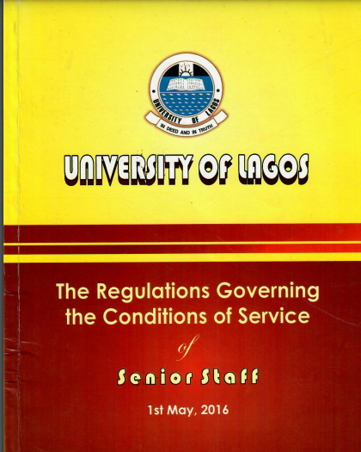

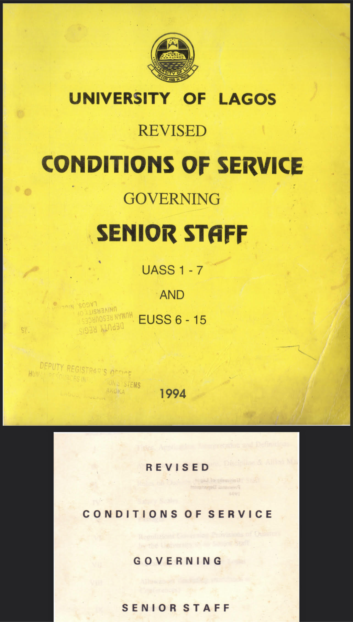
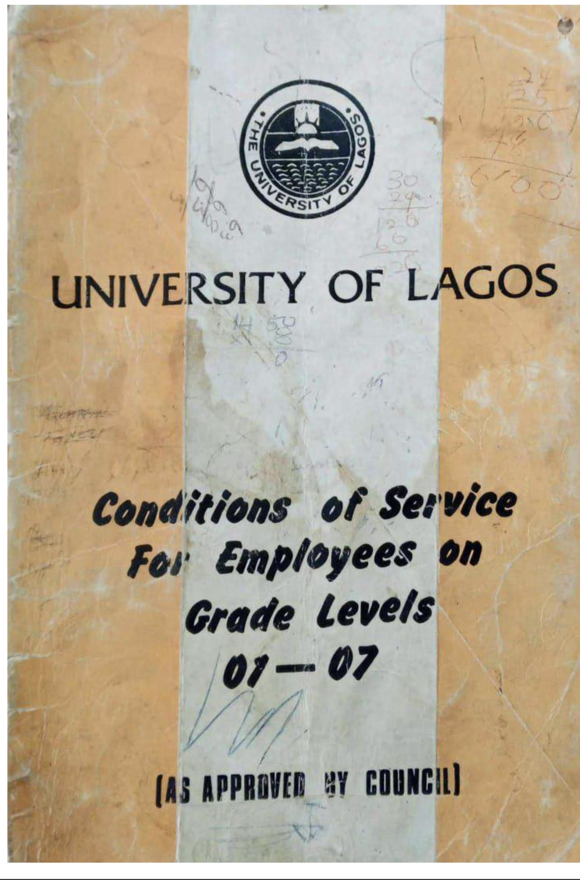
University Governance: Policies & Regulations
University governance is predicated on several policy documents including but not limited to the Conditions of Service and other extant circulars. FME and NUC has oversight functions,

Slide 16
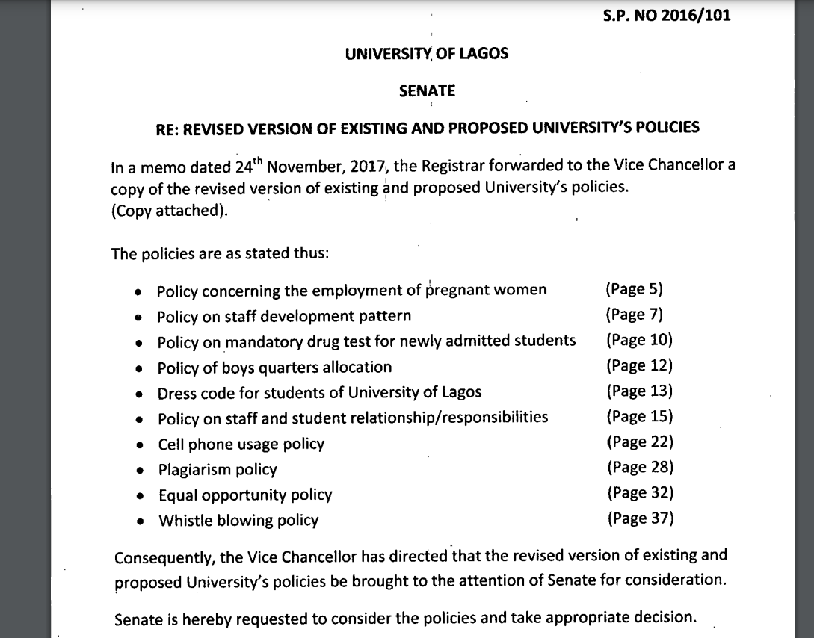
University Governance: Policies & Regulations
Policy on Students /Staff, Students/Students/ Staff/ Staff Romance and Romantic Relationship
E-Learning Policy
Research Policy
Research Ethics Policy
Ad-hoc Disciplinary Panels-
Investigative Panels/Administrative Panels/Disciplinary Panels

Slide 17


University Governance Mechanisms and Drivers
Now ………..Let,s pause !

Slide 18
Governance Mechanisms: Mission, Vision and Core Values
Mission
Core Values
Vision
To provide a conducive environment for teaching, learning, research and development, where staff and students will interact and compete effectively with their counterparts globally.“
“To be a Top Class Institution for the pursuit of excellence in knowledge, character and service to humanity.”
Commitment to Excellence in Learning and Character:
Conducive and Friendly Learning Environment:
Integrity and Respect:
Continuous Improvement of Staff Professionalism and Competence
Commitment to Continuous Improvement of all Facilities:
Enforcement of Innovative Culture and Ethical Conduct:
“ “

Slide 19
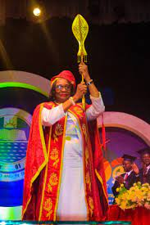
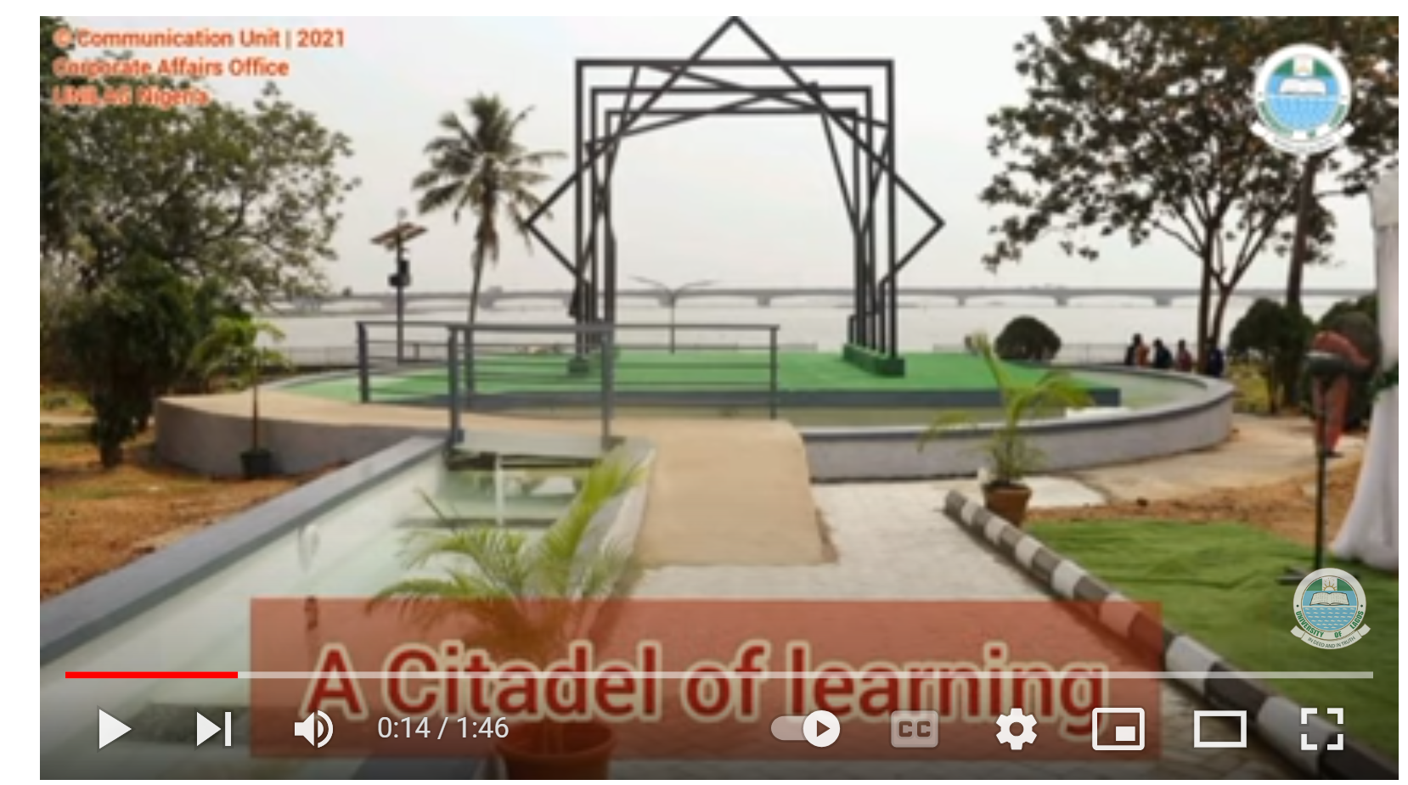

Governance –University Logo, Mace and Anthem
The logo of the University of Lagos is represented by a rising sun embedded in the green-white-green of the nation's flag a book and the lagoon, depicting academics and the natural environment of the University.
Verse 1:,
University of Lagos, the rising sun,
A fountain of excellence,
A Citadel of learning by the lagoon front,
Home of sound minds,
Chorus:
In Deed In Truth
We rise beyond the skies
Our Misson is to uphold our great heritage
We are the Nation’s Pride
The Mace

Slide 20
Governance –Academic Ceremonies /Regalia/ Faculty Colours
University Academic Ceremonies are:
➢ Convocation ceremonies for the award of degrees
and honorary degrees
➢ Matriculation
➢ Inaugural Lectures
➢ Valedictory Lectures
➢ Foundation Day Lectures
➢ Special Senate meetings in Honour of Departing
Vice-Chancellors or ranking Professors, and
➢ Installation of Chancellors and Vice-Chancellors
S/N | FACULTY/COLLEGE | APPROVED COLOURS
1 | Arts | White
2 | Education | Light yellow
3 | Engineering | Orange
4 | Environmental Sciences | Light grey
5 | Management Sciences | Green
6 | Law | Sky blue
7 | Pharmacy | Purple
8 | Science | Golden yellow
9 | Social sciences | Mint green
10 | College of medicine | Royal blue

Slide 21
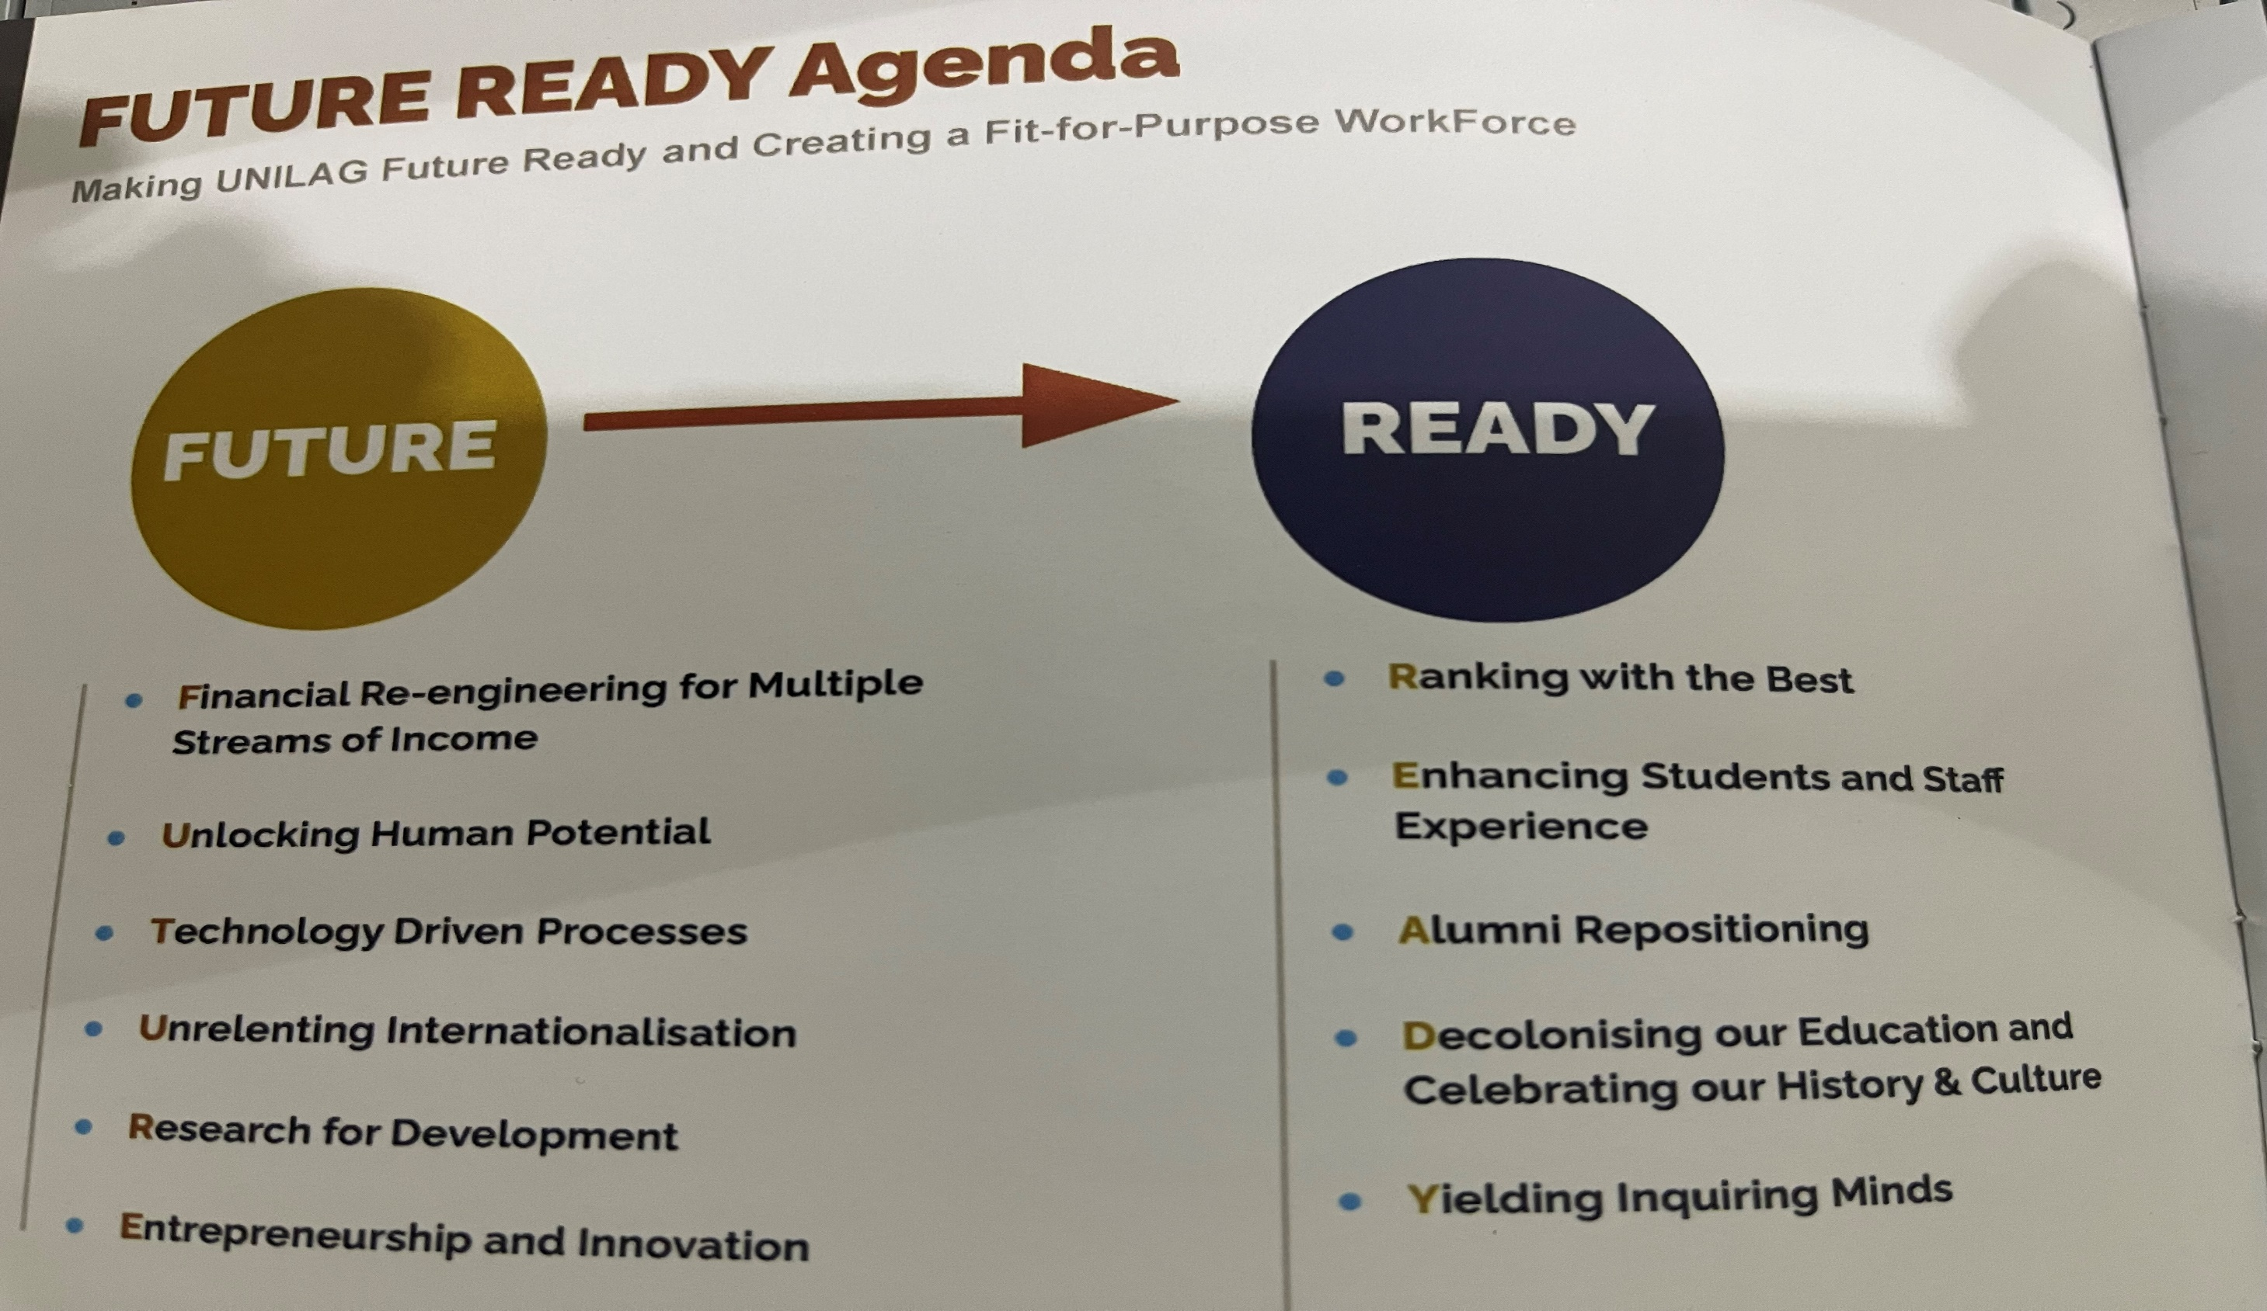
Governance: Strategic Sectors, Goals & Objectives
Themes
7 Strategic Sectors
Objectives
34 Objectives
Targets/ Goals
91 Targets/Goals
Tasks/Initiatives/Projects/Activities
667 Tasks at the Unit/Faculty/Department level

Slide 22
Strategic Sectors, Goals & Objectives
Sector | Objectives | Targets/Goals | Tasks/Projects
Academic Matters | 8 | 32 | 223
Student Matters | 4 | 7 | 126
Human Resources | 3 | 5 | 45
Physical Infrastructure | 9 | 30 | 110
Environment | 3 | 3 | 85
Health/Safety/ Security | 5 | 10 | 53
Finance | 2 | 4 | 25
Total | 34 | 91 | 667

Slide 23
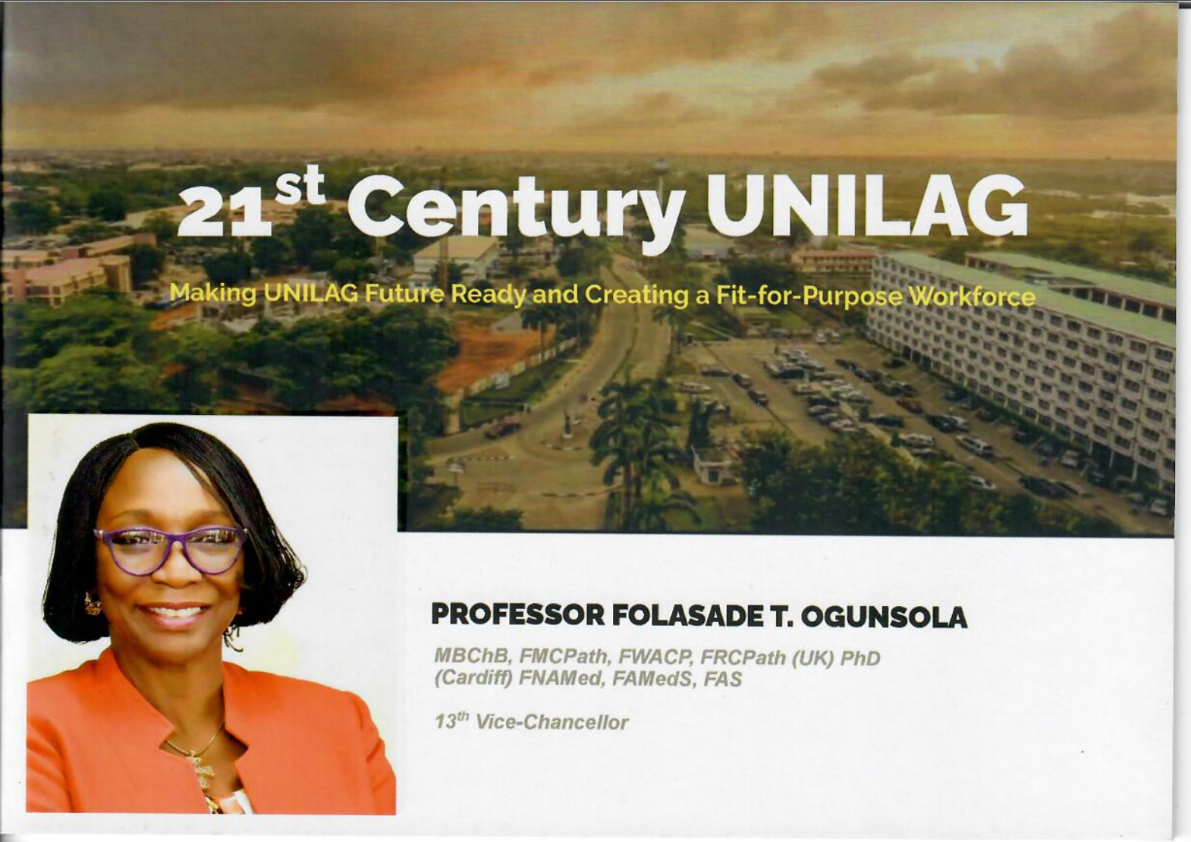

Slide 24
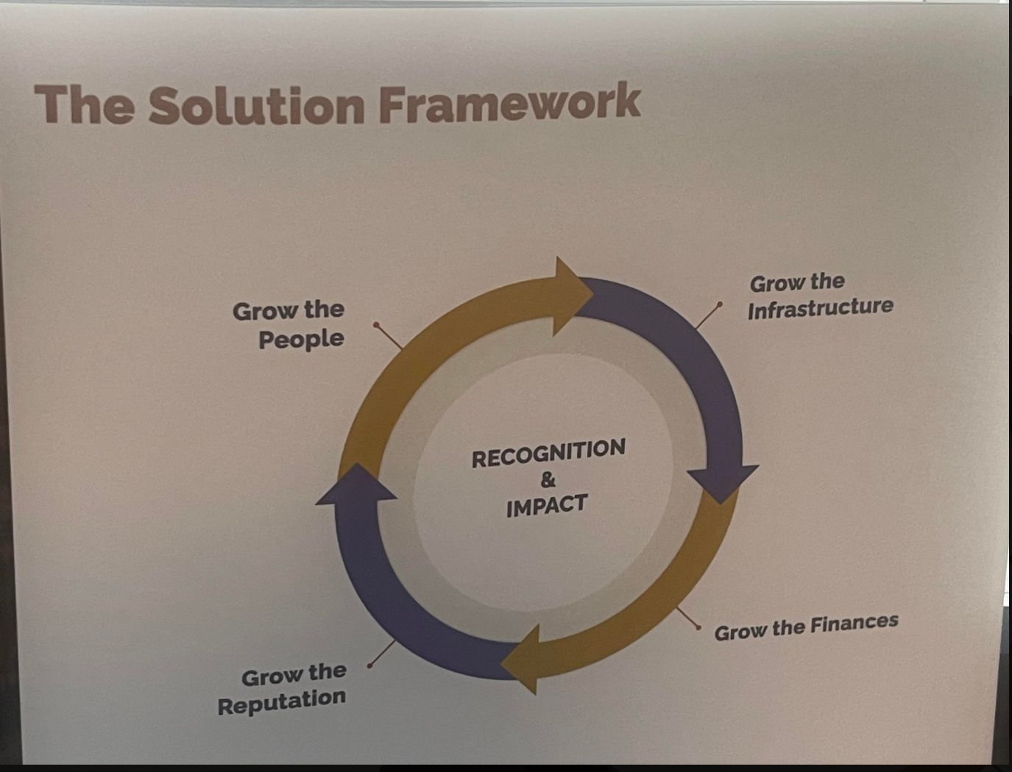

Slide 25
University Governance Roles and Responsibilities
Now ………..Let,s pause !

Slide 26
Vice-Chancellor
Deputy Vice-Chancellor
(Academics & Research)
Deputy Vice-Chanc
(Management Services)
Deputy Vice-Chancellor
(Development Services)
Registrar
Bursar
University
Librarian
Director,
Office of the
Vice-
Chancellor
Director,
Quality Assurance
Provost
Enterprises Services
Inter Relations
Partnership &
Prospect
Academic
Affairs
Council
Affairs Unit
Technical
Services
Director
Academic
Planning
Treasury
Technology
Transfer Office
Senate &
Ceremonies
Human
Resources
Readers’
Services
Head, Legal
Services
Dean
Students
Affairs
Branding
Services
International
Strategic
Partnership
Deans
Staff
Training
Final
Account
Globally Engaged
Learning
Admissions
Office
Research &
Bibliographic
Director,
Works &
Physical
Planning
Public policy
Impact
Director, DLI
& Societal
Office of
Advancement
Health &
Safety Unit
Director,
CITS
Research
Management
Records
Office
Budget &
Control
Automation
Director,
ICE
National
Computation
Infrastructure
Strategic
Communicat
ion
Entrepreneurship
Certificate &
Verification
Pension
IGUs
Chief Internal
Auditor
General
Administration
Home
Ownership
International
Student Recruitment
Security
Innovation & Technology Transfer
Properties
Strategic Project
& Partnership

Slide 27



University Governance :Roles and Responsibilities
Teaching & Learning
FOCUS AREAS:
Academic Staff
Research
Community
Service

Slide 28
University Governance :Roles and Responsibilities
Academic Support Units
AREA OF FOCUS:
Non Teaching Staff
Works Services, Municipal Services, Environment,Administration,
Student Affairs/Security

Slide 29
What is your ROLE in University Governance and Ethics?
38

Slide 30
Teaching, Research and Administrative- Leadership, Strategic Plan/Policies/Mails/Delegations
Statutory Meetings- Department, Board of Studies/Examiners/Senate
Departmental Committees-Scheme of Examiners,, Moderation of Questions, SERVICOM , Quality Assurance, Workplan, Schedule of Duties.
Budget Implementation- Procurement Planning and Financial Regulations
Staff Welfare: Promotion and Assessment of APER Forms/ Various Leaves/ Overtime Claims
Nominations for Trainings/TETFUND/Needs Assessment/ Conferences
Discipline - Queries/Misconduct-Staff and Students
Mentorship/ Tormentor ship
Municipal Services/
Security
Roles & Responsibilities
In University
Governance &Ethics

Slide 31

e-Governance: Future Ready UNILAG

Slide 32



Digital Native or Digital Immigrant?
A person born or brought up during the age of digital technology and so familiar with computers and the Internet from an early age (Oxford dictionary).
Someone who was born before the existence of digital technologies and adopted it to some extent later in life. (Urban Dictionary

Slide 33

e-Governance –Future Ready UNILAG
Technology Driven University :
Teaching and E-Learning - Pedagogy, Academic Records
Administration / Meetings –
  Governing Council,
  Senate,
  Management,
  Boards- Faculties & Statutory ;
  Committees- Statutory & Adhoc,
  Congregation,
  Convocation,
  Alumni, Congress,
  Cooperative Societies
Security/Crime Control – e Surveillance
Elections - Students, Senate, Council
Communication Unit - News Flash, Campus News, Website

Slide 35


Slide 36
Beyond The Philosophical....Case Studies--1
 The new HOD finds the predecessor had committed all funds for the rest academic year.

Slide 37
Beyond The Philosophical....Case Studies--2
 A highly-liked Departmental Secretary was involved in examination malpractice through sale of questions to selected students. This was established when a Lecturer in the department caught a student in an exam with prepared answer sheets. The general feeling of members of the department was that the matter should be dealt with at the departmental level with the Secretary seriously warned while HOD should seek his transfer

Slide 38
University Governance and Ethics - CONCLUSION

Slide 39


