Slide 1
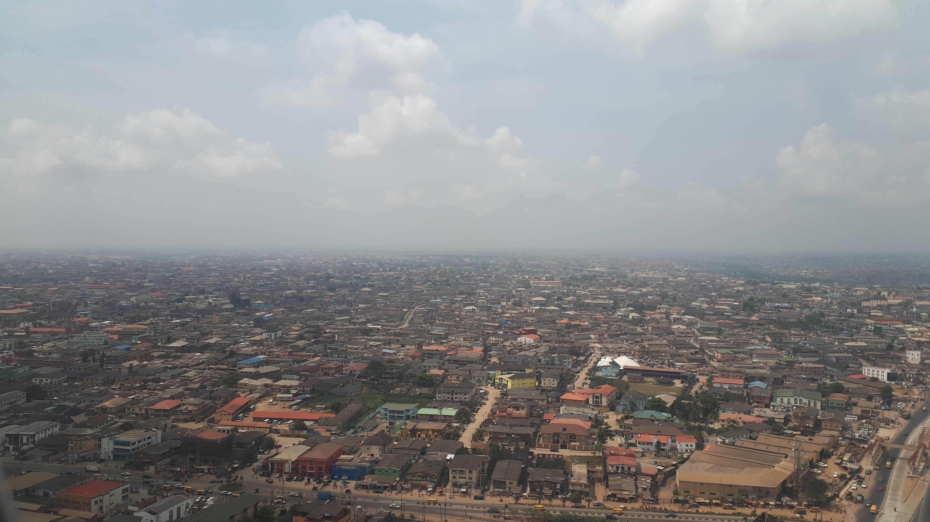
Pathways to Sustainable Urbanisation in Africa: Leaning on the Mabogunje Legacy
Prof Taibat Lawanson
Department of Urban and Regional Planning/
University of Lagos, Nigeria

Slide 2
Outline
1
2
3
4
5
Introduction: Africa’s urban trajectory: Matters Arising
Sustainable Urbanisation:Myth or possibility?
Deep Dive 1: Sustainable Urbanisation in Africa: Mabogunje intellectual Legacy
Deep Dive 2: Sustainable Urbanisation in Africa: Mabogunje Practice Legacy
Conclusion:
Towards Better Urban Futures:

Slide 3
Africa’s urban trajectory: Matters Arising

Slide 4
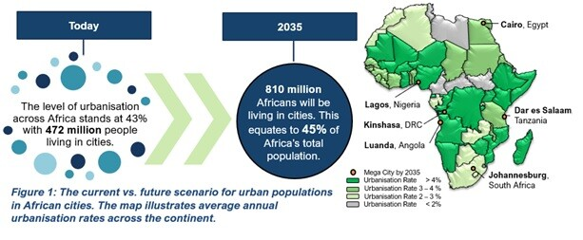
African urban areas are growing at an unprecedented rate and in a manner different from ‘established’ norms of urbanization. (World Bank, 2017).
Notes:
Africa is the fastest urbanizing region globally (African Devt Bank 2022),
Four out of every ten people in Africa live in cities (World Bank, 2023), with 60.8% live on ≤ US$2 daily,
The key features of Africa’s urban growth are that it is driven by a strong migration wave, bringing some of the poorest to cities (61.3% of all Africans live in slum-like conditions. It defies known economic theories and manifests as the urbanization of poverty

Slide 5
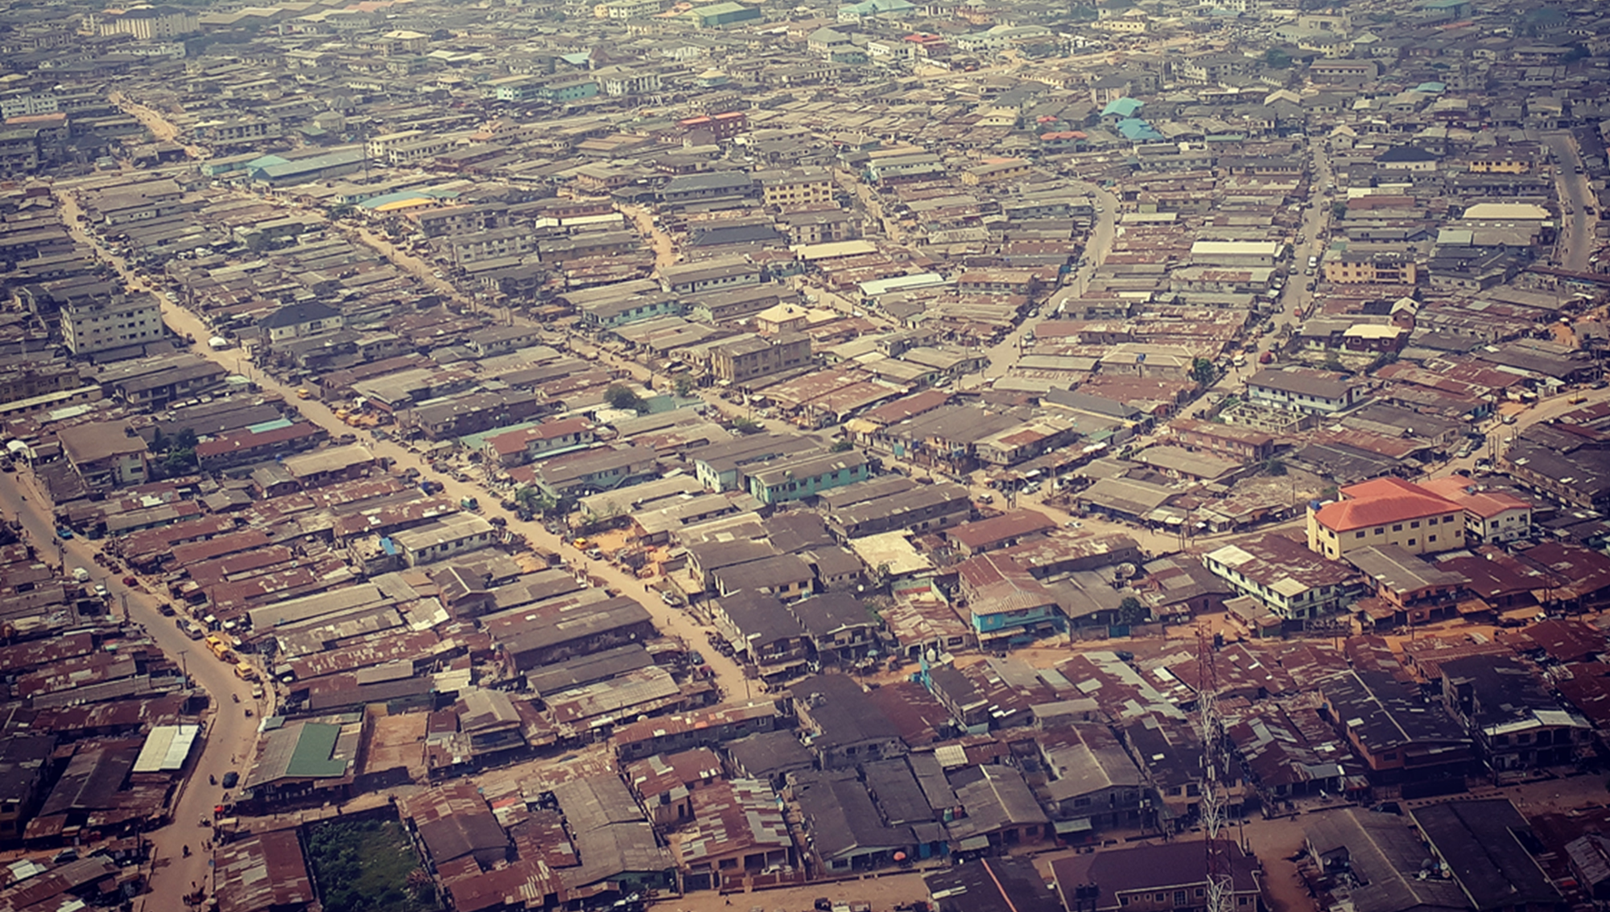
Urbanisation of Poverty
Youth bulge: almost 60% population aged ≤19years old
Poverty: 60.8% live on ≤ US$2 daily
Livelihoods: 80% in Informal Employment; Youth account for 60% of the Unemployed
Sources: Ibrahim Forum, 2019; UNDESA, 2014; World Bank, 2019).

Slide 6
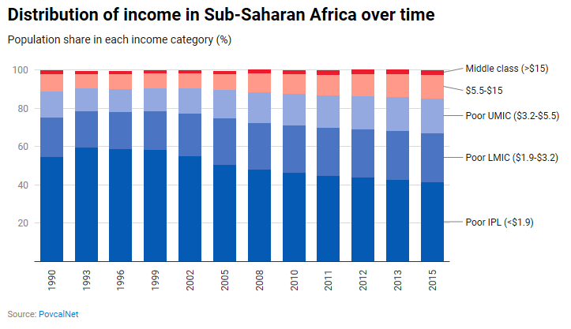
Intense socio-economic inequalities

Slide 7
Sustainable Urbanisation in Africa: Myth or possibility?

Slide 8


Urban Agenda
Agenda 2063 spells out a prosperous vision for the African continent, with a significant role for cities and human settlements, recognizing that ‘’Cities and other settlements are hubs of cultural and economic activities, with modernized infrastructure, and people have access to all the necessities of life including shelter, water, sanitation, energy, public transport and ICT…’’
The SDGs also recognize the catalytic role of cities in sustainable development, hence SDG11 is dedicated to ‘making cities and human settlements inclusive, safe, resilient and sustainable’.
Notes:
However, the patterns of urban development across many African cities falls short of the targets of these global development agendas as well as the grand aspirations of African leaders.

Slide 9

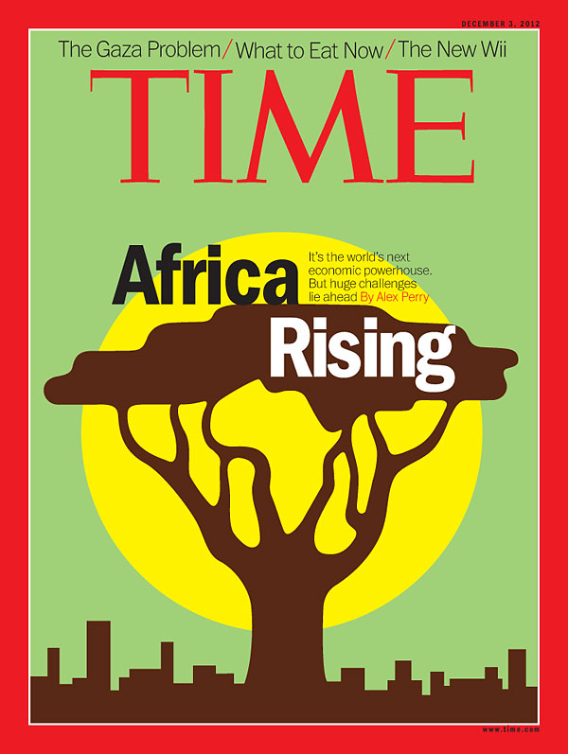

Africa Rising narrative
There is a prevalent reality of urban poverty across many African cities and a contradictory ‘’Africa Rising,, rhetoric driven by globalizing interests who paint a picture of a continent flourishing via the growth of an emerging middle class with westernised consumption patterns.
Notes:
Madam Vice Chancellor

Slide 10
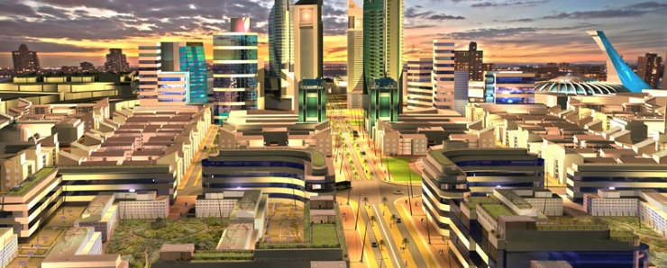
Konza Technopolis, Nairobi
Notes:
And Akon City in Dakar

Slide 11
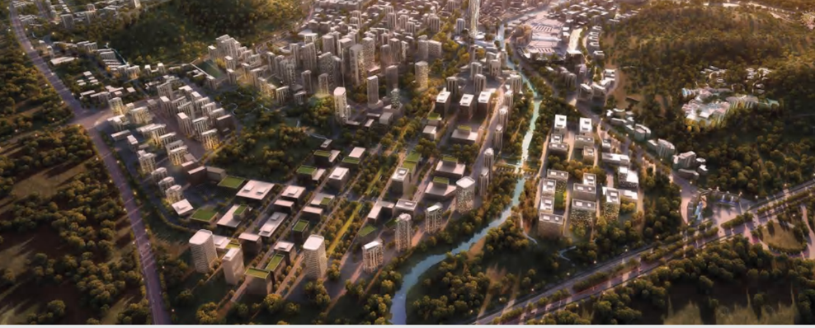
Abuja Centenary City, Nigeria
Notes:
From Eko Atlantic city in Lagos to Hope city in Accra,

Slide 12
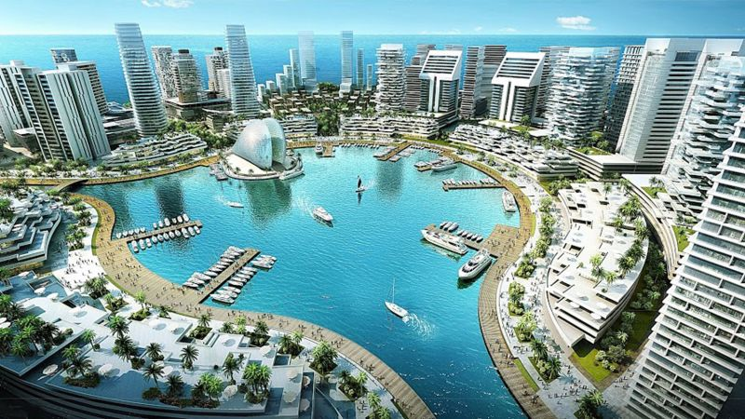
‘’Now we think we can sandfill and extend the land into the ocean which is what we're trying to do in the Atlantic City. Of course, some of the consequences of that would not be immediately obvious. And so, we might enjoy the freedom of our technological capabilities for some years but we don't know what we really displace.
Now I'm trying to show that this is not to say we can't exercise our God-given technological capabilities; if we’re disturbing nature, nature has a way of coming back at us,,
              - Mabogunje..on Land reclamation

Slide 13
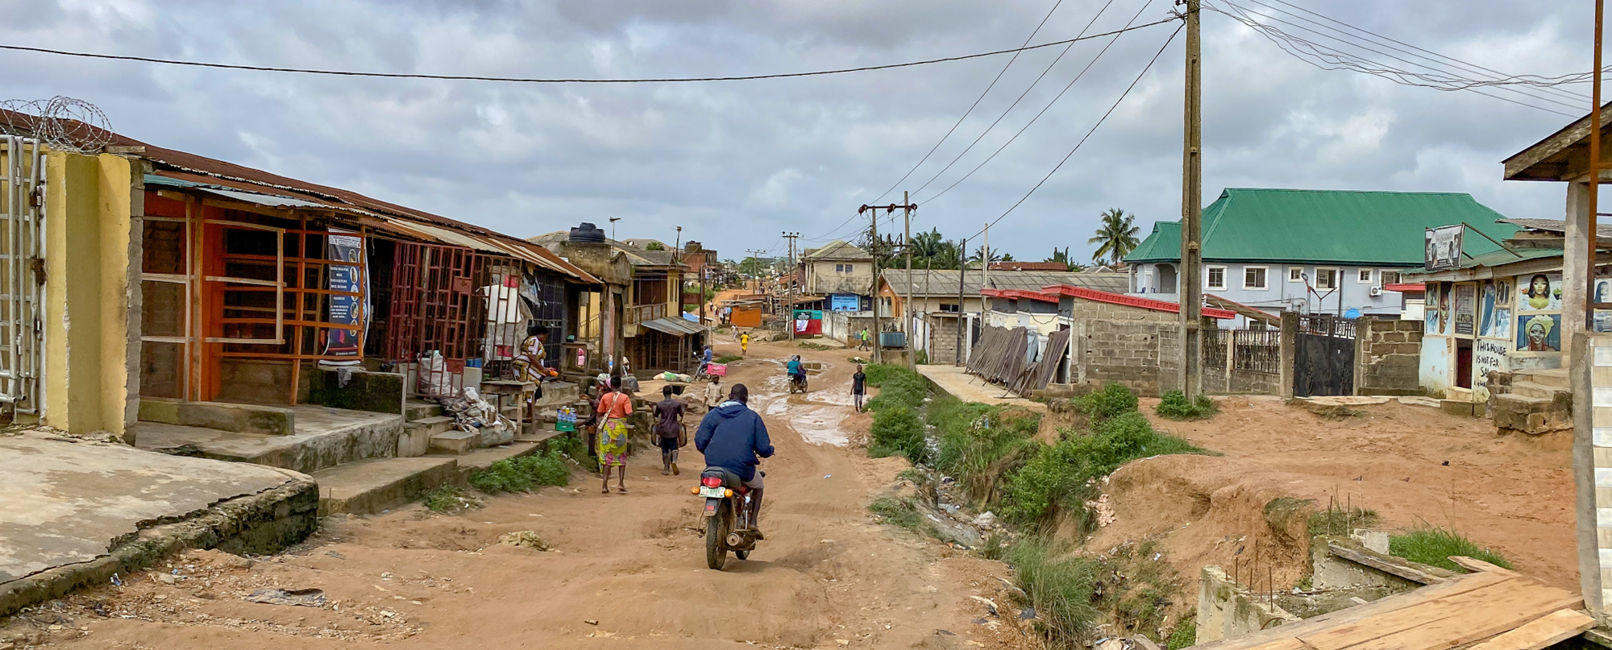
Abeokuta, Nigeria
Notes:
However attempts at implementing them have resulted in increasing socio-economic inequalities, gentrification and socio-spatial fragmentation (Lawanson and Omoegun, 2018).

Slide 14
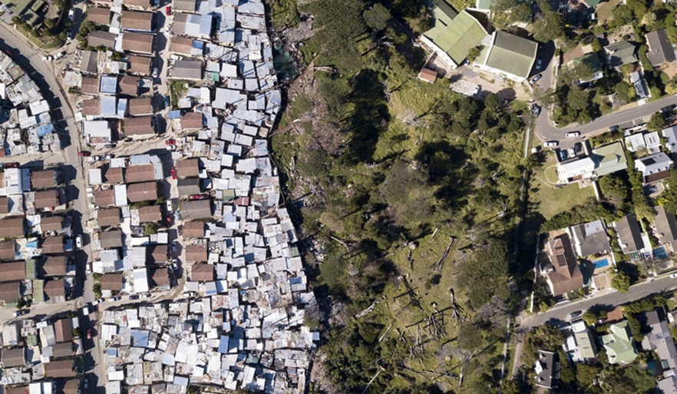
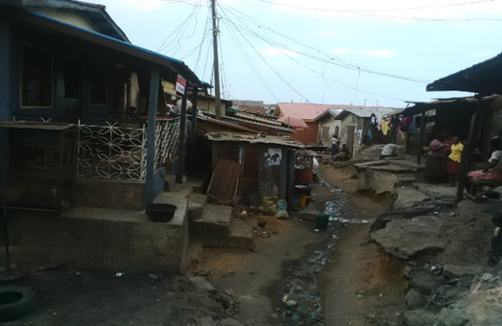
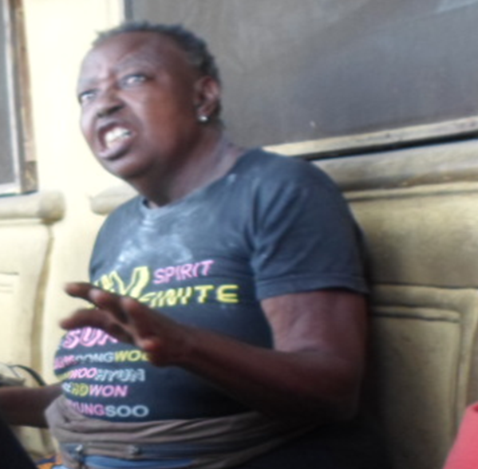
These new cities.....intensify incongruencies between the “plan” and the reality on the ground.
“The plan is beautiful, the new city is good, but who are they for………Where are normal people going to sleep tonight?,,
Notes:
Exacerbate the dual city paradigm, which manifests as the sharp spatial segregation between formal and informal systems, as well as planned and unplanned areas. They fall far short of addressing the real challenges of African cities, and are nothing short of ‘urban fantasies’.
Mama Agnes, a retired nurse and property owner in Bariga close to us here at the university had this to say about the plan of Eko Atlantic City

Slide 15
Deep Dive 1: Sustainable Urbanisation in Africa:
Mabogunje INTELLECTUAL Legacy

Slide 16
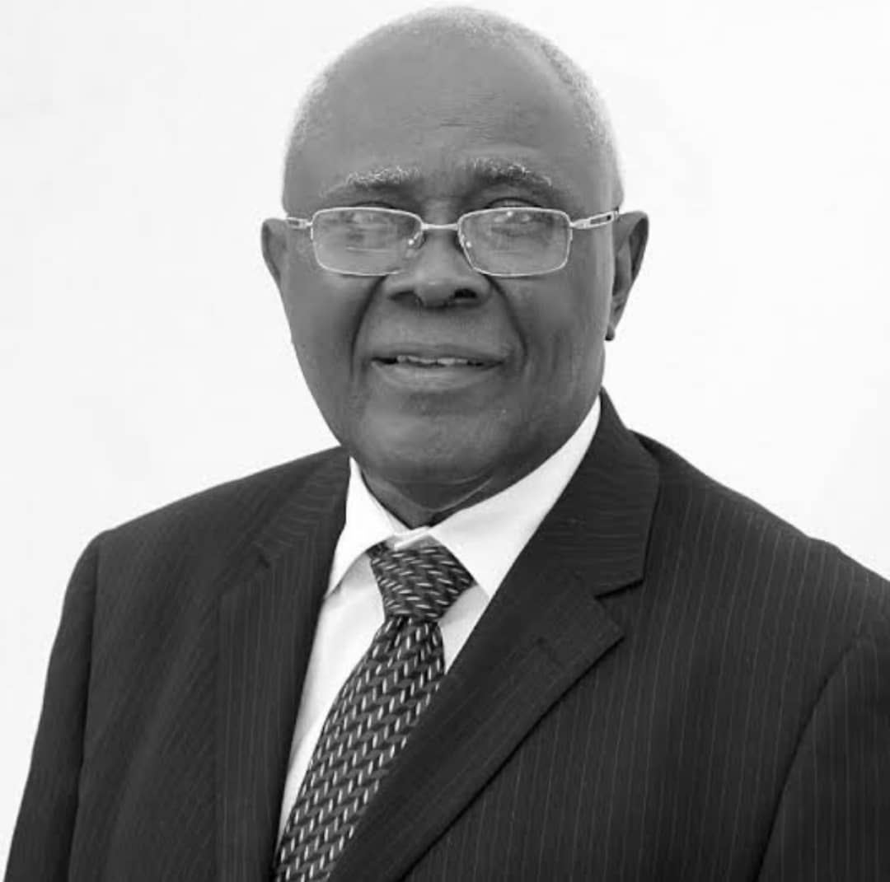
Decolonial Thinking:
In his work, Mabogunje challenged the relevance of western explanations of urban development in relation to the urbanisation process in Africa. For him, simply and uncritically transferring theories of urban growth developed in Global North provided little meaningful explanation of African urbanisation.
He was arguably the first geographer to ‘Africanise’ thinking and to break out of the colonial mindset and mode of thought. His work situated African cities properly within the global knowledge ecosystem. He was central to the development of Geography as a university subject not only in Nigeria but Africa.
Prof. Mabogunje’s pioneering role reverberates in the annals of disciplines like geography, urban and regional planning, development studies and the social sciences generally to the extent that he provided the theoretical focus that have prompted scientific investigations in understanding issues of urbanization and its implications for national development particularly in Nigeria, and indeed, the rest of Africa (Coquery-Vidrovitch 2005).
Coquery-Vidrovitch, C. 2005. Introduction: African Urban Spaces: History and Culture In: Salm, Stephen & Falola, Toyin. African Urban Spaces in Historical Perspective. Rochester: Rochester University Press
Notes:
and succeeded in decentering Eurocentric epistemologies of development that had become the fascination of both scholars and practitioners involved in development planning. He set the agenda for a new kind of conversation about thinking and doing development in Africa.

Slide 17
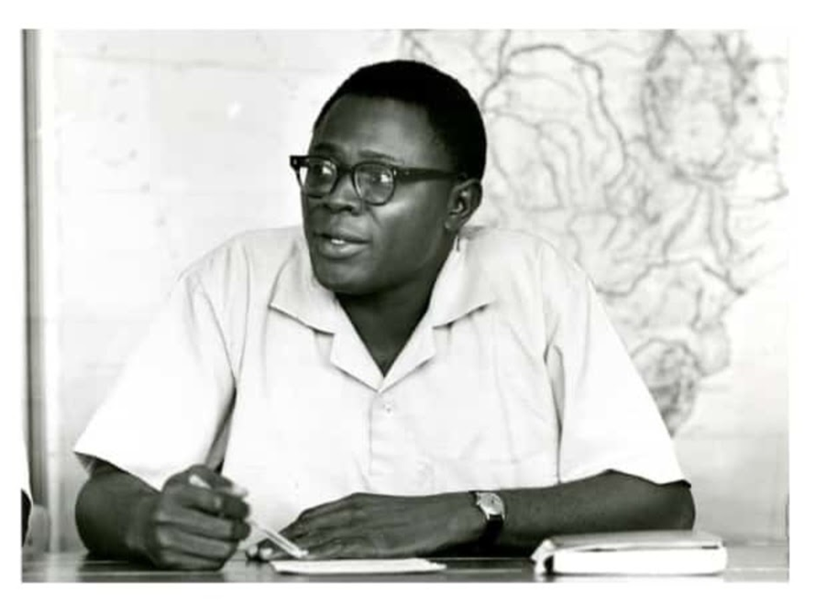
Multidisciplinarity:
  ‘’Exploring wider fields of knowledge could do no harm but expand your own intellectual horizon. If you are able to see the interrelationship between such fields of knowledge and your own area of preference, you would have gained immeasurably in your understanding of your field,,
  - Akin Mabogunje, 2011
Mabogunje. A. 2011 A measure of Grace. Ibadan:Book builders Publishers

Slide 18
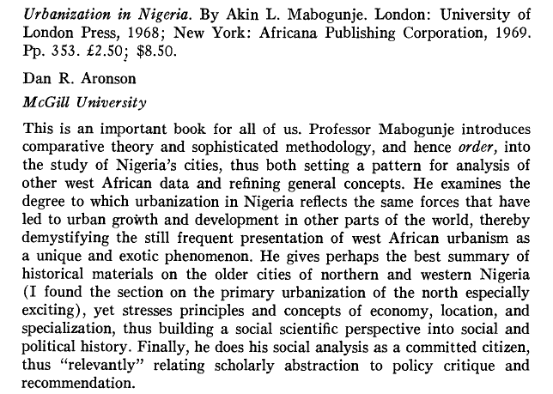
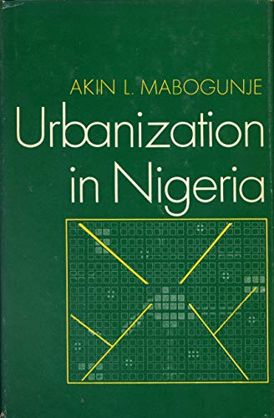
Aronson, D. R. (1971). [Review of Urbanization in Nigeria., by A. L. Mabogunje]. American Journal of Sociology, 77(2), 382–384. http://www.jstor.org/stable/2776906

Slide 19
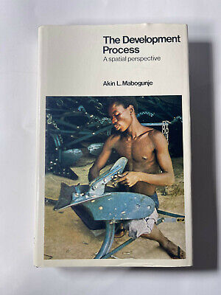
Mixed Methods research
His historical training provided and understanding of ‘the substantive development process of a people over time in space’, but in order to move beyond the description of landscape change and towards an understanding of process and explanation of change, quantitative approaches were required.
Together, historical and quantitative methods could provide insights into the development process. Using this approach, he published his second major monograph, The Development Process: A Spatial Perspective in 1980.
Craggs R & Lawanson. T (forthcoming). ‘Akin Mabogunje’ in Mary Gilmartin, Phil Hubbard, Rob Kitchin and Sue Roberts (eds)Key thinkers on Space and Place (3rd Edition). Sage

Slide 20
Deep Dive 2: Sustainable Urbanisation in Africa:
Mabogunje PRACTICE Legacy

Slide 21
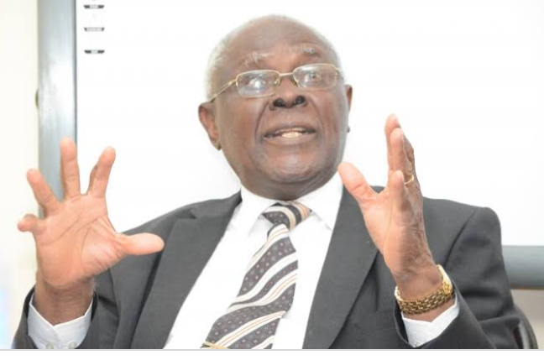
Redefining Development
‘’Development should be the process of moving whole social systems upward, so as to enhance the capacity of each member of society to realize his inherent potential and to effectively cope with the changing circumstances of his life. It is essentially a human issue, concerned with mobilizing communities and the whole society to engage in the task of self improvement with the resources available to it,, - Akin Mabogunje 1989
Mabogunje, Akin. 1989. Coping with Structural Adjustment: The Nigerian Experience. In: Cohen, R. ed. Satisfying Africa’s Food Needs: Food Production and Commercialisation in African Agriculture. Carter Studies on Africa. Boulder: Lynne Rienner Publishers
Notes:
Development, for Prof. Mabogunje transcended statistical growth in a country’s Gross National Product or Gross Domestic Product to functional ways of organizing productive forces in both rural and urban settlements in ways that lead to specialization and segregation of activities by functions.

Slide 22
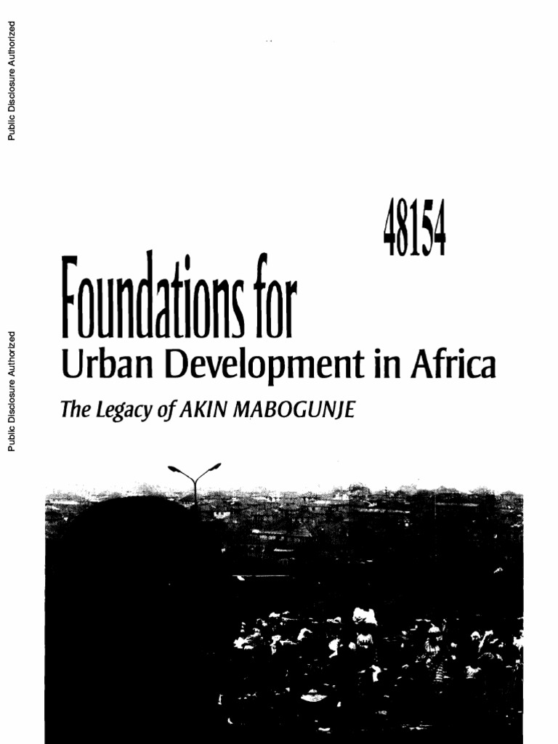
To this end, he became a highly demanded Consultant to governments and international organisations, and provided much needed intellectual and practical support for Nigeria’s development programmes.
Professor Akin Mabogunje was the quintessential Scholar Stateman.
From housing to land administration, rural development to local governance, Microfinance to poverty alleviation, metropolitan governance to social inclusion, new cities to regional development, Professor Mabogunje had an opinion that was grounded in science, and recommended solutions that were practical, feasible and scaleable.
Unfortunately, while governments listened to him, many a time, they did not implement his suggestions

Slide 23
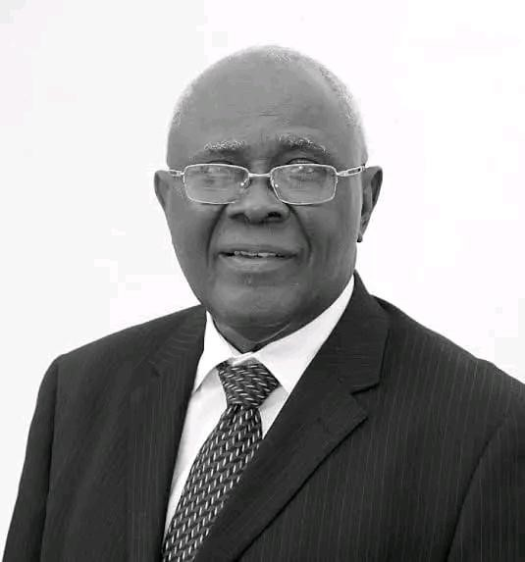
A few of his contributions
Abuja Capital City
Lagos Megacity
Land Reforms
Migration
Housing and Mortgage Sector
Regional Development
Industrialisation
Local Government Reforms
Community Development and Traditional Governance
Tertiary Education
Pan African Development
Poverty Alleviation
Ijebu Development Initiative

Slide 24
Recognition of the urban scale
  The major challenges of local government around urbanization is in fact the problem of the bigger, higher level of government. Most African governments don't see their urban centers as places that should be established to generate the finances needed to provide services.
  The real problem is that the Constitution of Nigeria does not recognize the concept of urban. And practically all our problems are tied to urban governance.
Rural urban Migration
  Now, if you fail to develop the rural area, but you're doing social services like education and so on, as soon as the younger people have enlightenment and start to see what opportunities there are in the cities they will move. So whether you develop the rural area or you don’t, people will move. When people talk about we must stop it, it's like stopping the wave, you know? You go to the state and say you want to stop the tide when it must come - it's impossible!

Slide 25
Land Use Act
      ‘’That's another thing the military did by telling us the governors are the custodian of our land. How can they be? You can't take people's land without extinguishing their rights! Because if the state government says he gave you a C of O, the owners of the land then wait with their cutlass and say tell the governor if this is his father's land, that he can, you know, simply give it out, extinguish my right without consequence......In fact, it's part of our problem of development. I can't even sell my land because there is no title.....That is what the land reform was, to be able to do a systematic survey of people's land. And say this is yours, this is mine; here’s my title document agreed to by Government,,

Slide 26
Conclusion:
Towards better African Urban Futures:

Slide 27
From research to practice, there is need to leverage what Professor Mabogunje professed over the course of his life .....
Embrace Decolonial Thinking
Research the urban through Multidisciplinarily lens and mixed methodologies
Encourage co-production and Transdisciplinarity in urban knowledge production
Recognise the role of cities as places of opportunity and wealth creation
Prioritise the social considerations for development
Revisit migration and dichotomous rural – urban linkages
Enable effective Land reforms and land rights
Practice sustainable urban Management, including decentralisation and local governance

